Slide 1
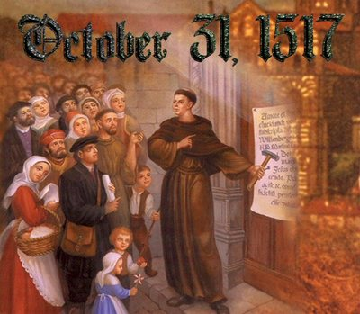
Protestant Reformation 1517
AIM: Why would people start questioning the power of the Catholic church?
Do Now: What Renaissance Philosophy caused a look away from the Roman Catholic church?

Slide 2
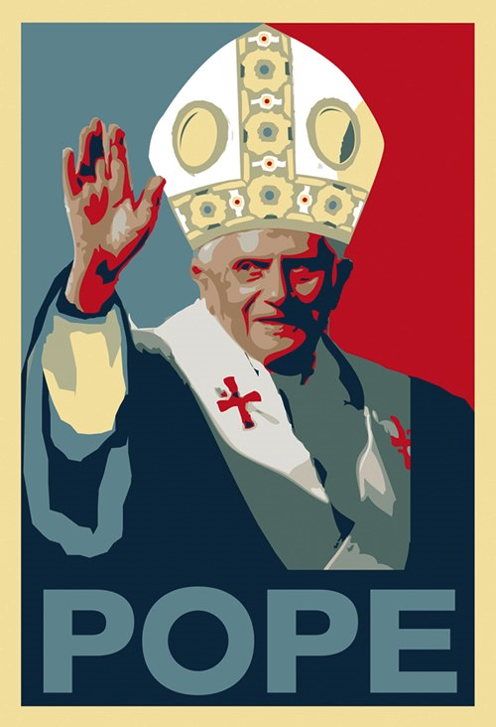
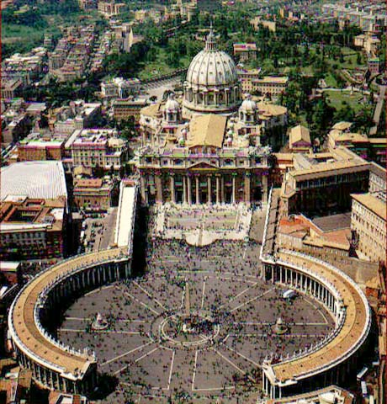
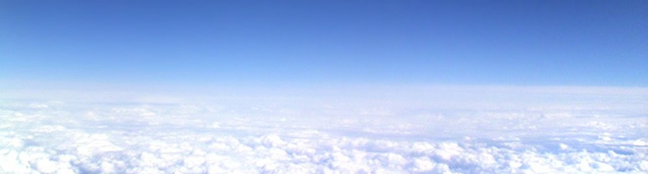
Protestant Reformation
What was the Protestant Reformation?
TO
Protest
Reform
What/Who?
Roman Catholic Church

Slide 3
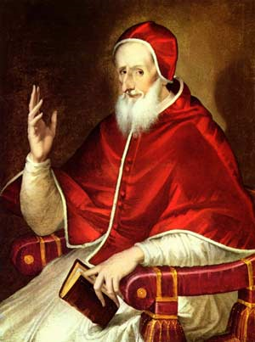
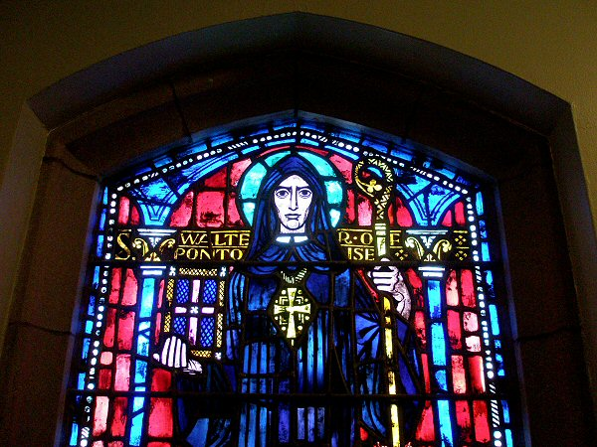
What had become the biggest authority figure of the Middle Ages?
The
Pope
The Middle Ages
The Catholic
Church

Slide 4
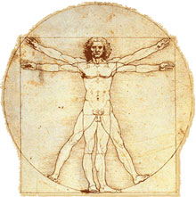

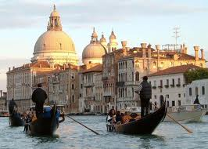
Renaissance's effect
People began to question their lives and church authority. WHY?
The Plague
Questioned their faith
Humanism
Trade
Focus on the Individual
Rise of Wealth &
the Middle Class

Slide 5
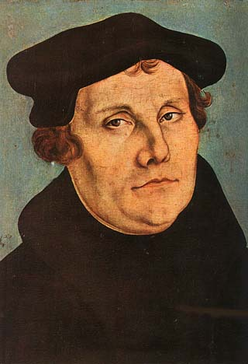
Martin Luther- 1517
German monk
Questioned Churches practices
  Sale of indulgences by
  “ selling forgiveness for sins” (Automatic trip to heaven in the after-life by paying the church to forgive your sins)

Slide 6
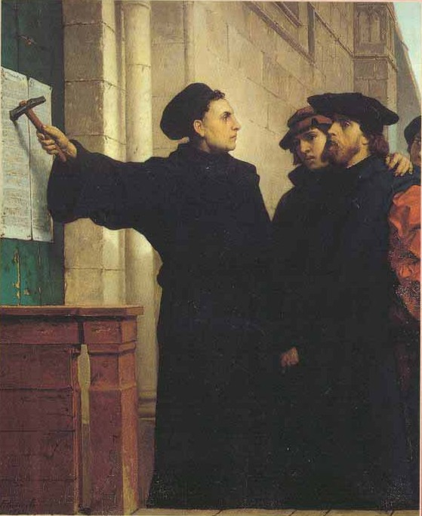
95 Theses
Luther was so upset at church he decided to write down the
95 Theses (95 things church is doing wrong) and nails them to the church in Wittenberg (Germany)

Slide 7
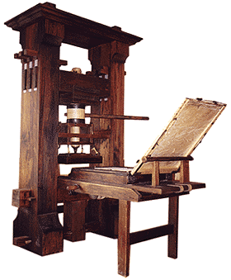
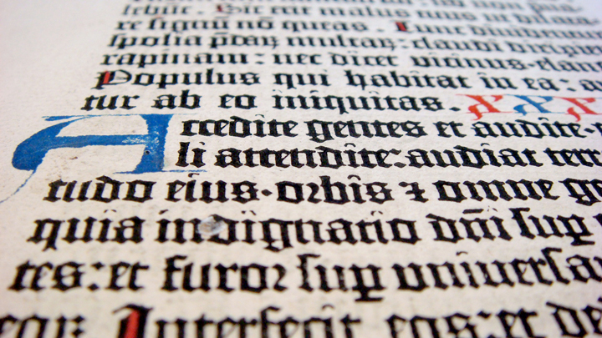
How did this become such a big deal?
Effect of the printing press – ideas are spread faster
Opened people’s eyes to church malpractices (wrong doings)

Slide 8
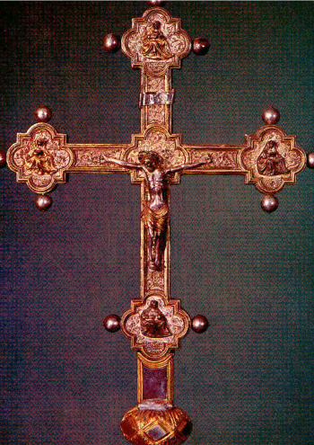
Martin Luther
“Faith Alone” will save you
All should read the Bible in their own vernacular (language)
Priests do not have special powers
Simplify the sacraments to baptism and communion
Religious Education for all

Slide 9
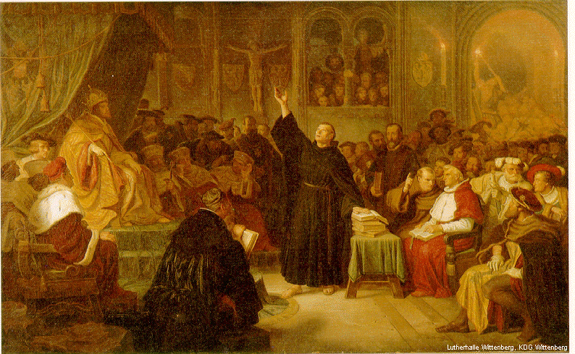
Church’s Reaction?
Let him say what he wants
Nope!
Want Martin Luther to recant (take back) what he said @
Diet of Worms
  Diet – group/assembly
  Worms is a place in Germany
Don’t let him get away with it
Yup! Punish Him

Slide 10
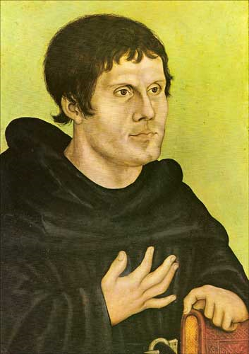
Luther’s Response to the Church
NO WAY DUDE!
Hier stehe ich. Ich kann nicht anders. Gott helfe mir. Amen." ("Here I stand. I can do nothing else. God help me.)
He is excommunicated (banned) from the church and forced into hiding for the rest of his life

Slide 11
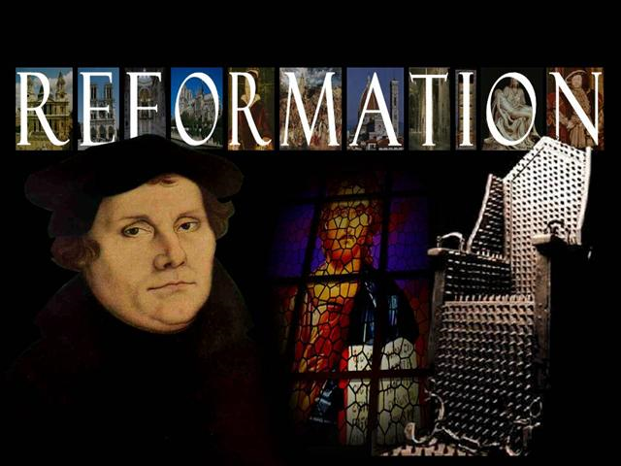
Activity: Complete Worksheet

