Slide 1

Emotions, Stress, and Health
Chapter 8B

Slide 2
Emotions, Stress, and Health
Theories of Emotion
Embodied Emotion
  Emotions and The Autonomic Nervous System
  Physiological Similarities Among Specific Emotions
  Physiological Differences Among Specific Emotions
  Cognition And Emotion

Slide 3
Expressed Emotion
  Detecting Emotion
  Gender, Emotion, and Nonverbal Behavior
  Culture and Emotional Expression
  The Effects of Facial Expressions

Slide 4
Experienced Emotion
  Fear
  Anger
  Happiness

Slide 5
Stress and Health
  Stress and Illness
  Stress and the Heart
  Stress and Susceptibility to Disease
Promoting Health
  Coping With Stress
  Managing Stress

Slide 6

Emotion
Emotions are our body’s adaptive response.

Slide 7
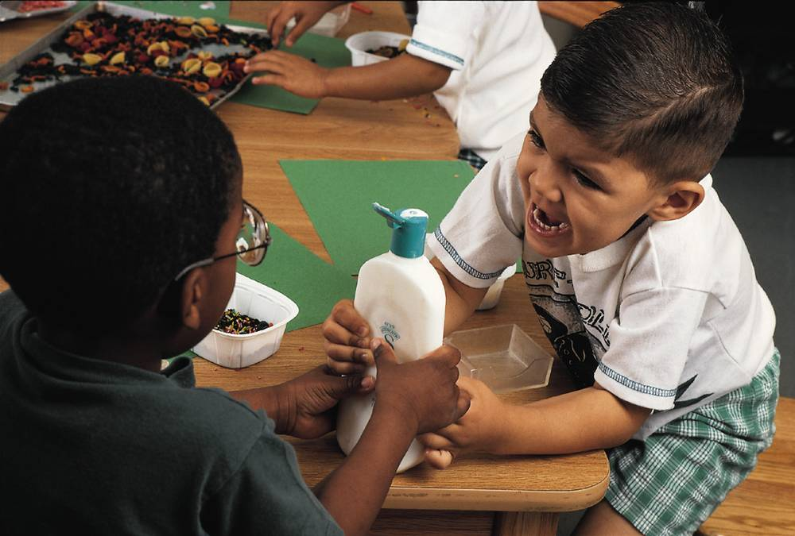
Theories of Emotion
Emotions are a mix of 1) physiological activation, 2) expressive behaviors, and 3) conscious experience.
Notes:
Preview Question 1: What are the components of an emotion?

Slide 8
Controversy
Does physiological arousal precede or follow your emotional experience?
Does cognition (thinking) precede emotion (feeling)?

Slide 9
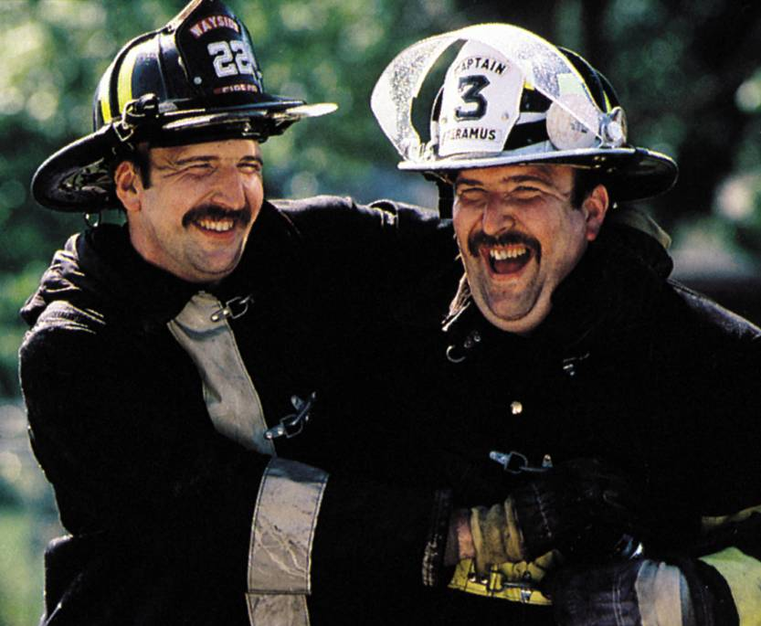
Commonsense View
When you become happy, your heart starts beating faster. First comes conscious awareness, then comes physiological activity.
Bob Sacha

Slide 10
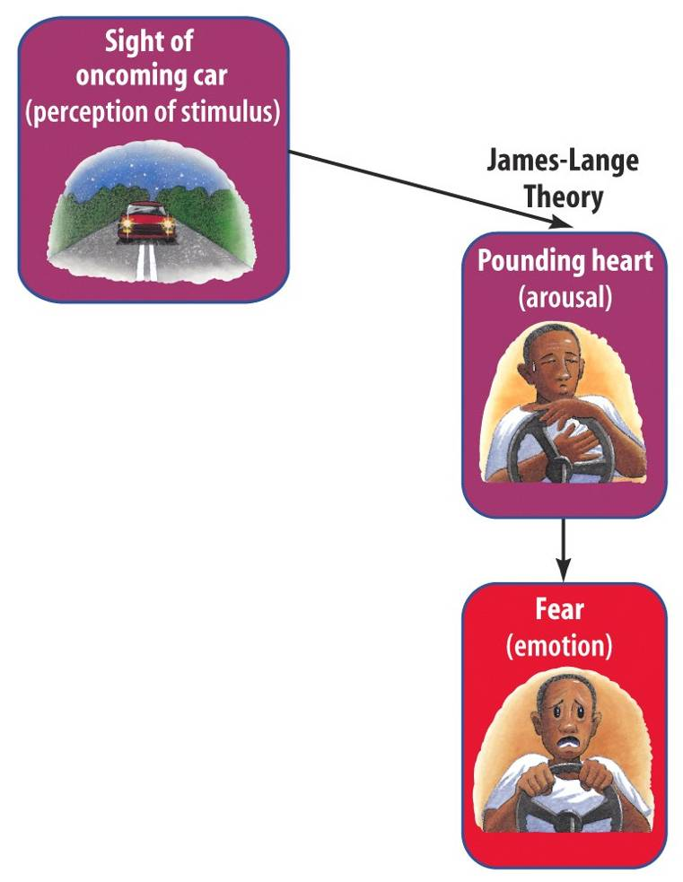
James-Lange Theory
William James and Carl Lange proposed an idea that was diametrically opposed to the common-sense view. The James-Lange Theory proposes that physiological activity precedes the emotional experience.

Slide 11
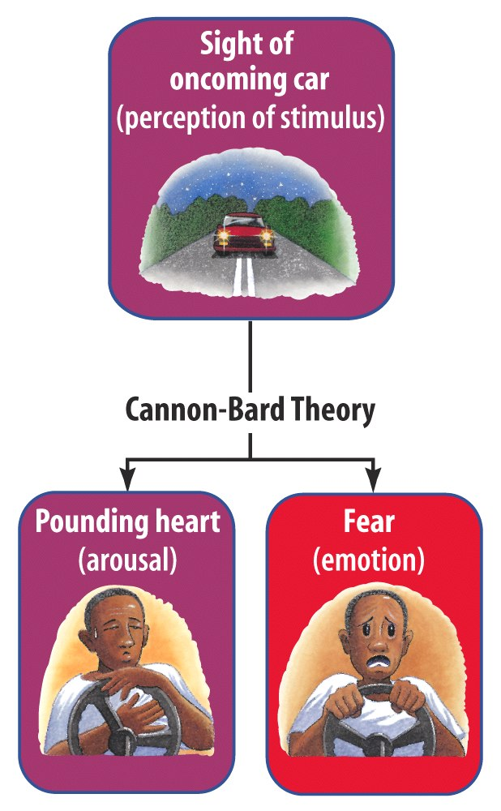
Cannon-Bard Theory
Walter Cannon and Phillip Bard questioned the James-Lange Theory and proposed that an emotion-triggering stimulus and the body's arousal take place simultaneously.

Slide 12
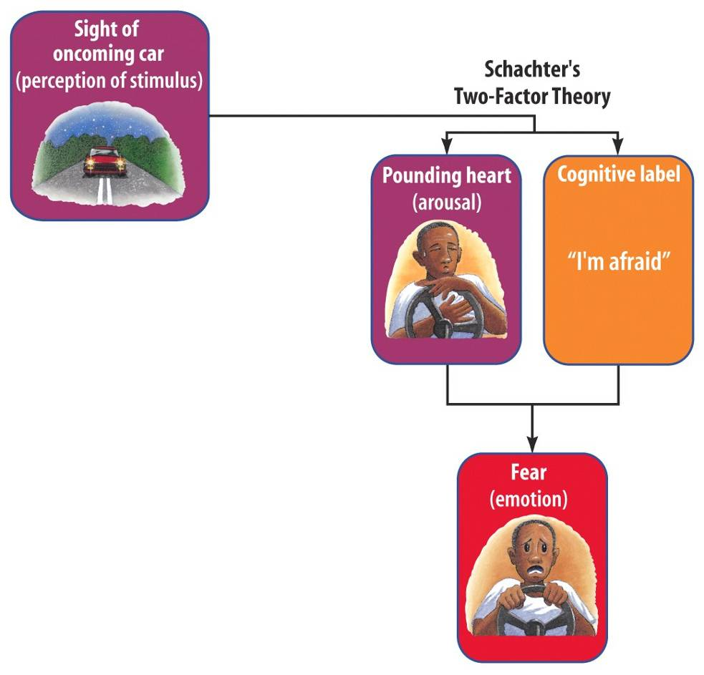
Two-Factor Theory
Stanley Schachter and Jerome Singer proposed yet another theory which suggests our physiology and cognitions create emotions. Emotions have two factors–physical arousal and cognitive label.

Slide 13
Embodied Emotion
We know that emotions involve bodily responses. Some of these responses are very noticeable (butterflies in our stomach when fear arises), but others are more difficult to discern (neurons activated in the brain).

Slide 14
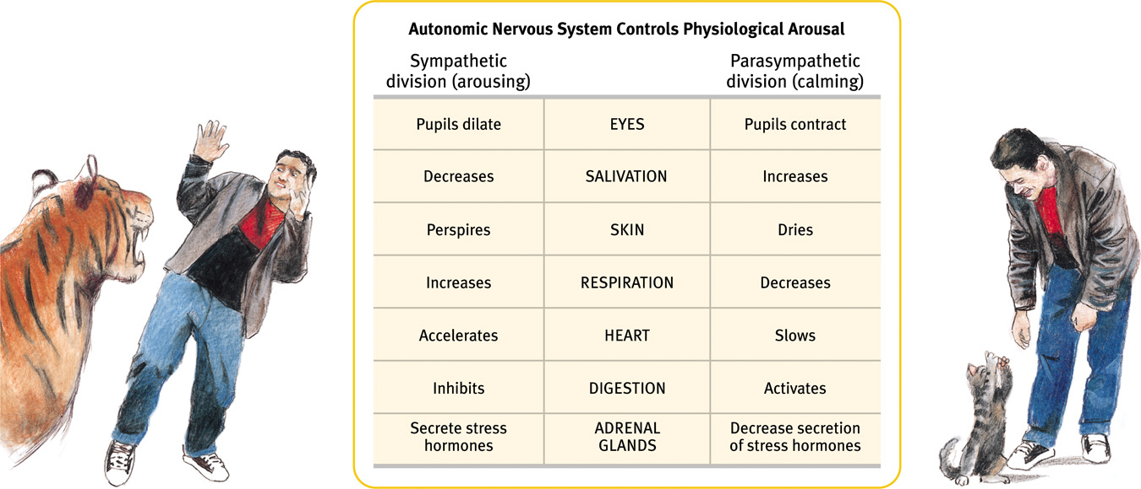
Emotions and the Autonomic Nervous System
During an emotional experience, our autonomic nervous system mobilizes energy in the body that arouses us.
Notes:
Preview Question 2: What is the link between emotional arousal and the autonomic nervous system?

Slide 15
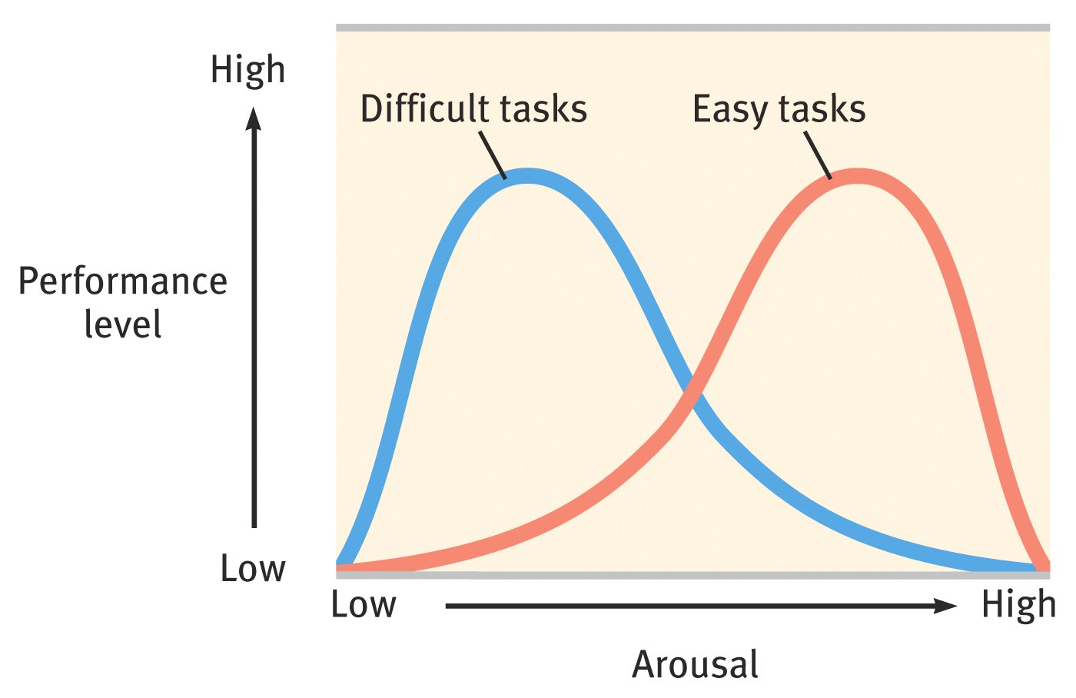
Arousal and Performance
Arousal in short spurts is adaptive. We perform better under moderate arousal, but optimal performance varies with task difficulty.

Slide 16
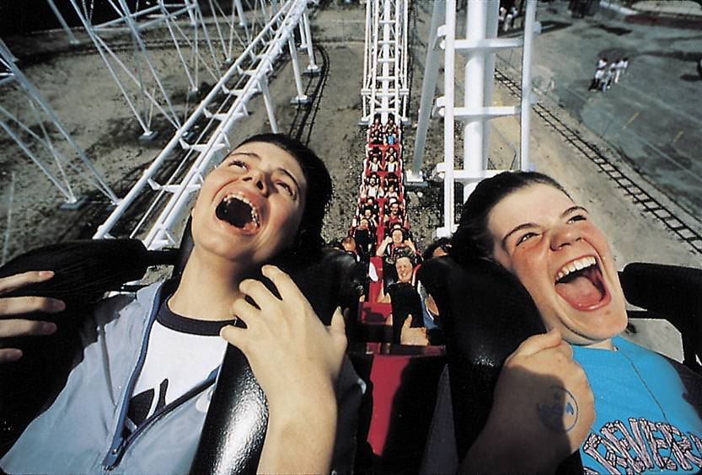
Physiological Similarities
Physiological responses related to the emotions of fear, anger, love, and boredom are very similar.
M. Grecco/ Stock Boston
Excitement and fear involve a similar
physiological arousal.
Notes:
Preview Question 3: Do different emotions activate different physiological and brain-pattern responses?

Slide 17
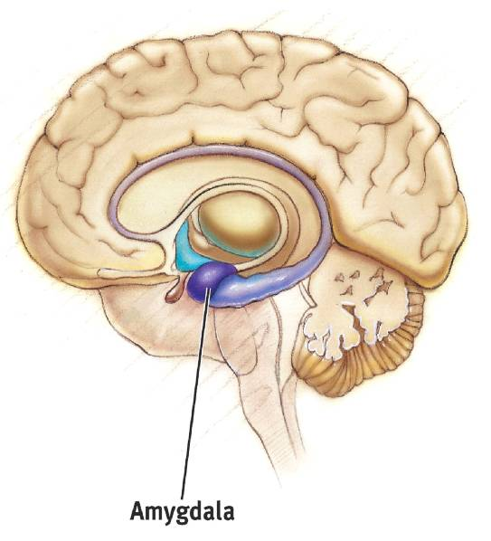
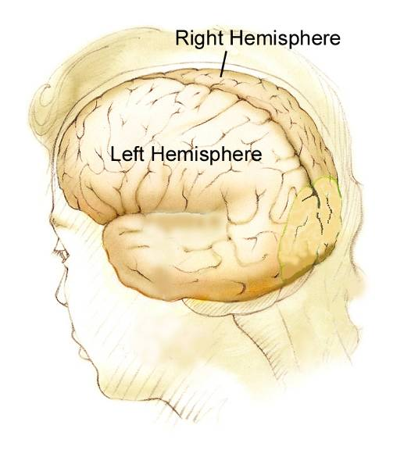
Physiological Differences
Physical responses, like finger temperature and movement of facial muscles, change during fear, rage, and joy.
The amygdala shows differences in activation during the emotions of anger and rage. Activity of the left hemisphere (happy) is different from the right (depressed) for emotions.

Slide 18
Cognition and Emotion
What is the connection between how we think (cognition) and how we feel (emotion)?
Can we change our emotions by changing our thinking?
Notes:
Preview Question 4: To experience emotions, must we consciously interpret and label them?

Slide 19
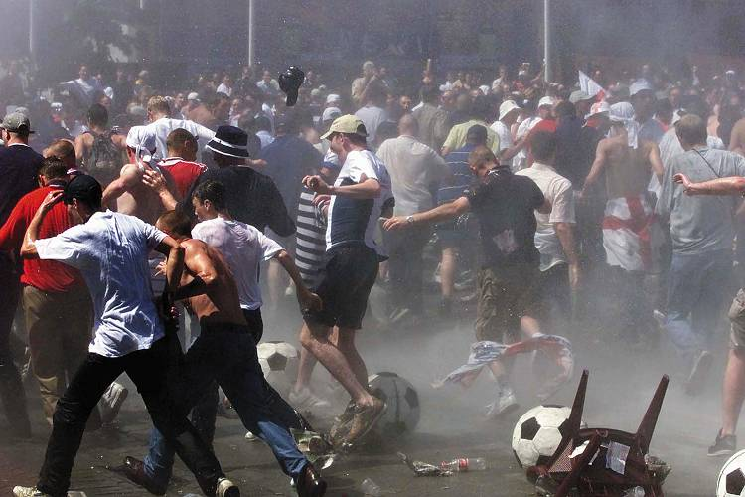
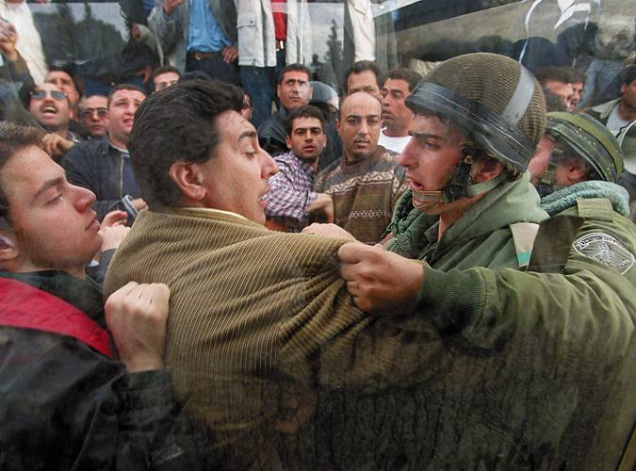
Cognition Can Define Emotion
An arousal response to one event spills over into our response to the next event.
AP Photo/ Nati Harnik
Reuters/ Corbis
Arousal from a soccer match can fuel anger, which may lead to rioting.

Slide 20
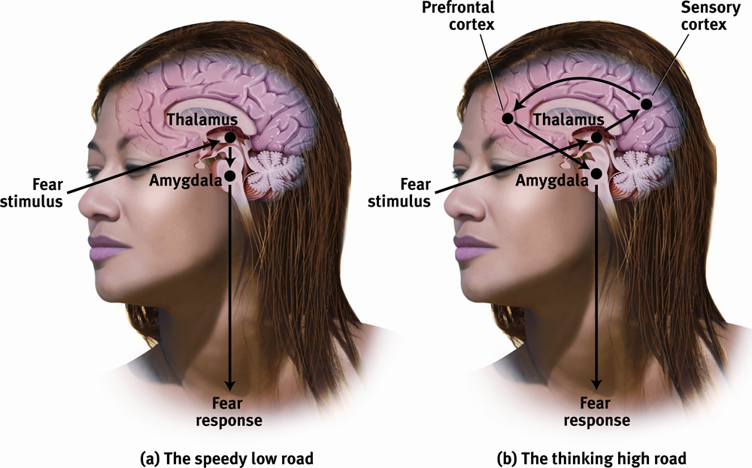
Cognition Does Not Always Precede Emotion
A subliminally presented happy face can encourage subjects to drink more than when presented with an angry face (Berridge & Winkeilman, 2003).
Emotions are felt directly through the amygdala (a) or through the cortex (b) for analysis.

Slide 21
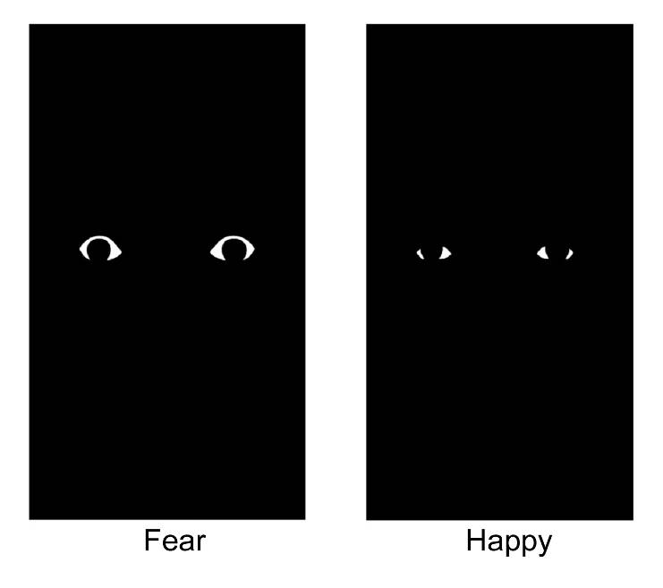
Cognition Does Not Always Precede Emotion
When fearful eyes were subliminally presented to subjects, fMRI scans revealed higher levels of activity in the amygdala (Whalen et al. 2004).
Courtesy of Paul J. Whalen, PhD, Dartmouth
College, www.whalenlab.info

Slide 22
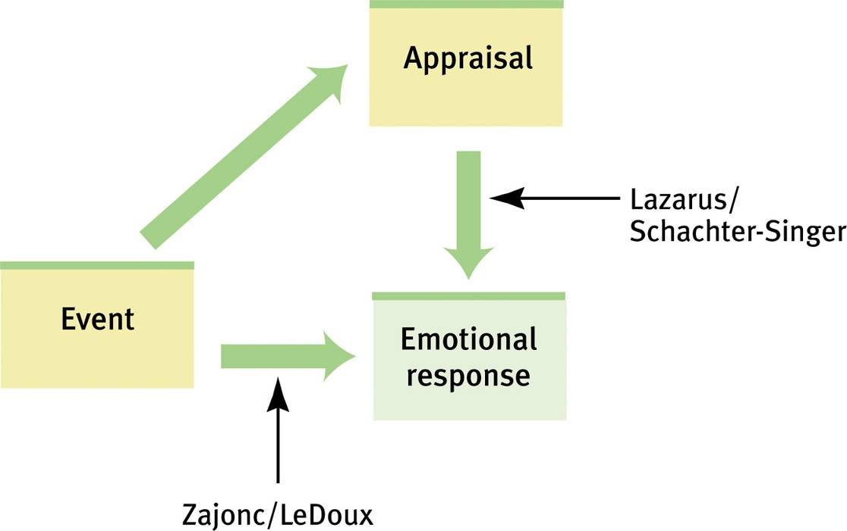
Two Routes to Emotion
Zajonc and LeDoux emphasize that some emotions are immediate, without conscious appraisal. Lazarus, Schachter, and Singer emphasize that appraisal also determines emotions.

Slide 23
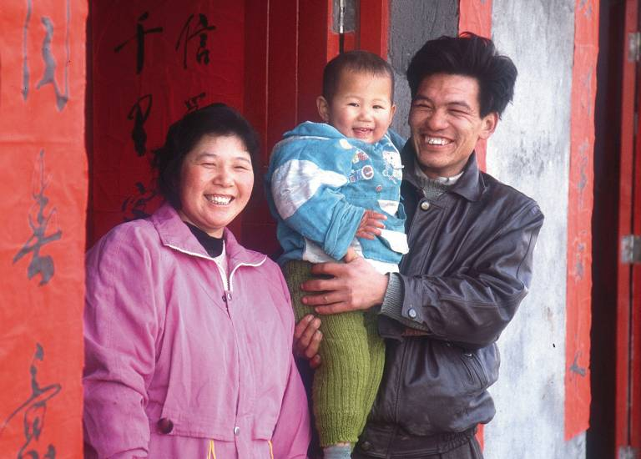

Expressed Emotion
Emotions are expressed on the face, by the body, and by the intonation of voice. Is this nonverbal language of emotion universal?
Notes:
Preview Question 5: How do we communicate nonverbally?

Slide 24
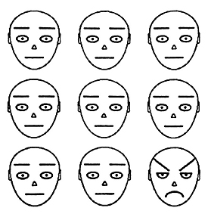
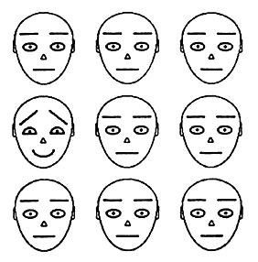
Detecting Emotion
Most of us are good at deciphering emotions through nonverbal communication. In a crowd of faces a single angry face will “pop out” faster than a single happy face (Fox et al, 2000).

Slide 25
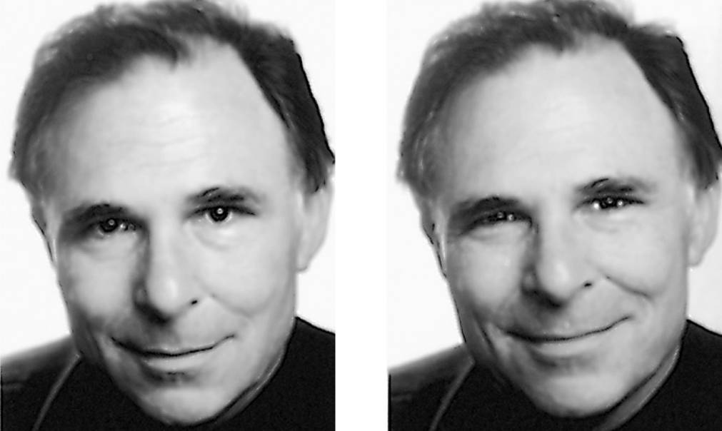
Detecting Emotion
Hard-to-control facial muscles reveal signs of emotions you may be trying to conceal. A feigned smile may continue for more than 4-5 seconds while a genuine smile will have faded by then.
Dr. Paul Elkman, University of California at San Francisco
Which of Paul Ekman’s smiles is genuine?

Slide 26
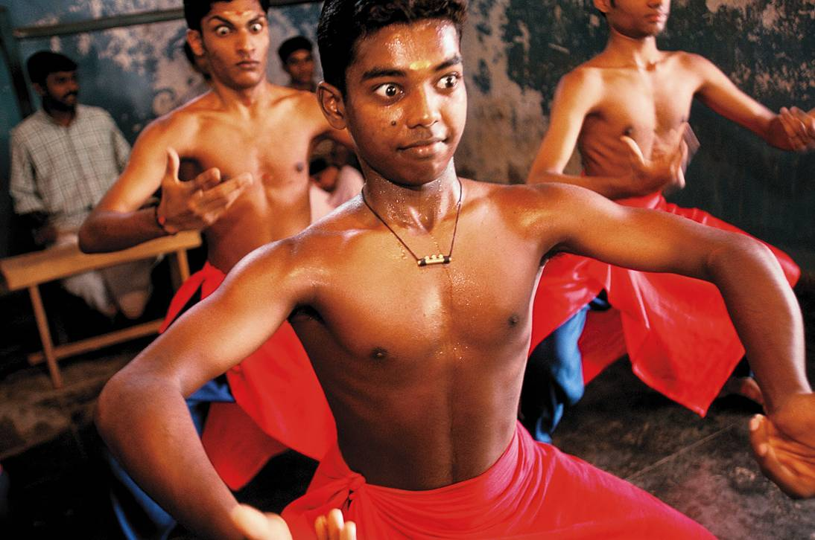
Hindu Dance
In classical Hindu dance, the body is trained to effectively convey 10 different emotions.
Network Photographers/ Alamy

Slide 27
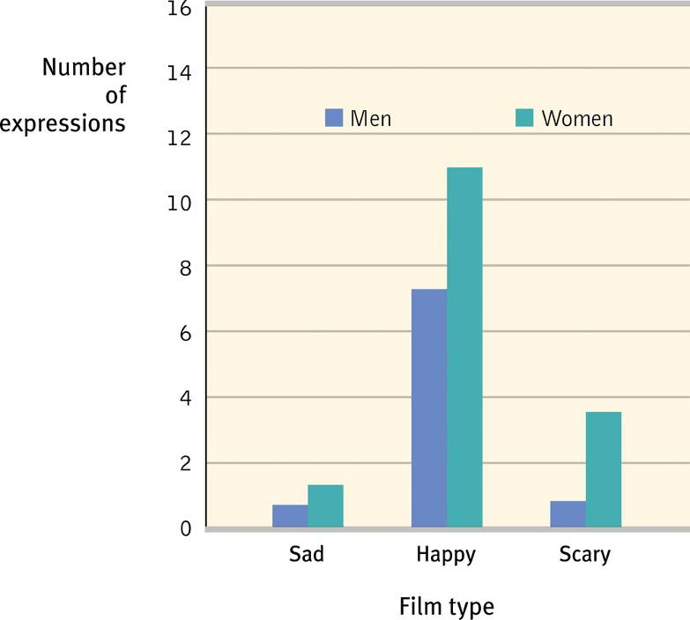
Gender, Emotion, and Nonverbal Behavior
Women are much better at discerning nonverbal emotions than men. When shown sad, happy, and scary film clips women expressed more emotions than men.

Slide 28
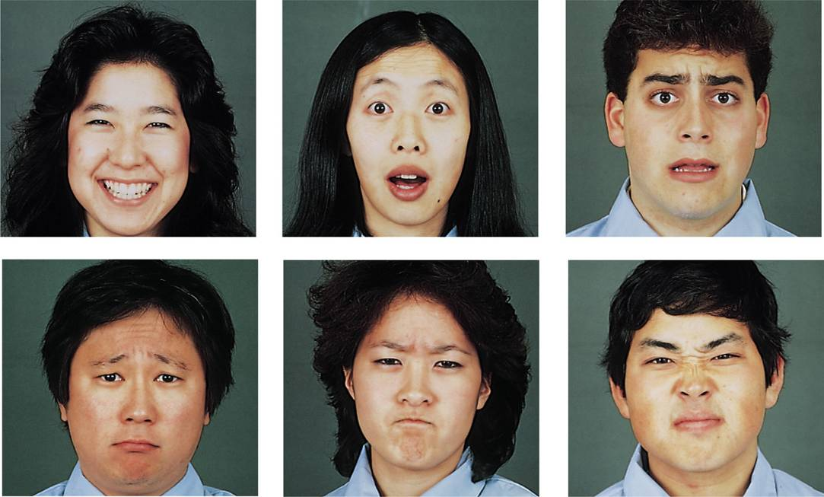
Culture and Emotional Expression
When culturally diverse people were shown basic facial expressions, they did fairly well at recognizing them (Matsumoto & Ekman, 1989).
Elkman & Matsumoto, Japanese and
Caucasian Facial Expression of Emotion
Notes:
Preview Question 6: Are nonverbal expressions of emotion universally understood?

Slide 29
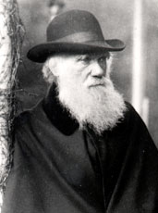
Emotions are Adaptive
Darwin speculated that our ancestors communicated with facial expressions in the absence of language. Nonverbal facial expressions led to our ancestor’s survival.
Charles Darwin (1809-1882)

Slide 30
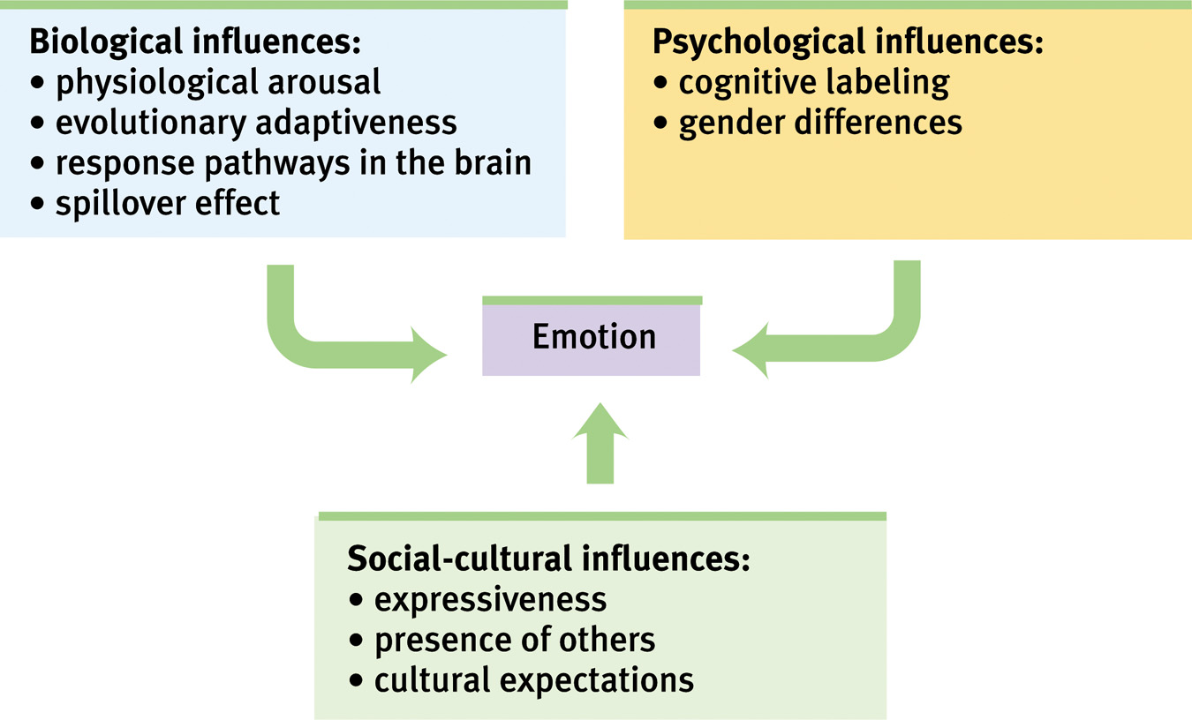
Analyzing Emotion
Analysis of emotions are carried on different levels.

Slide 31
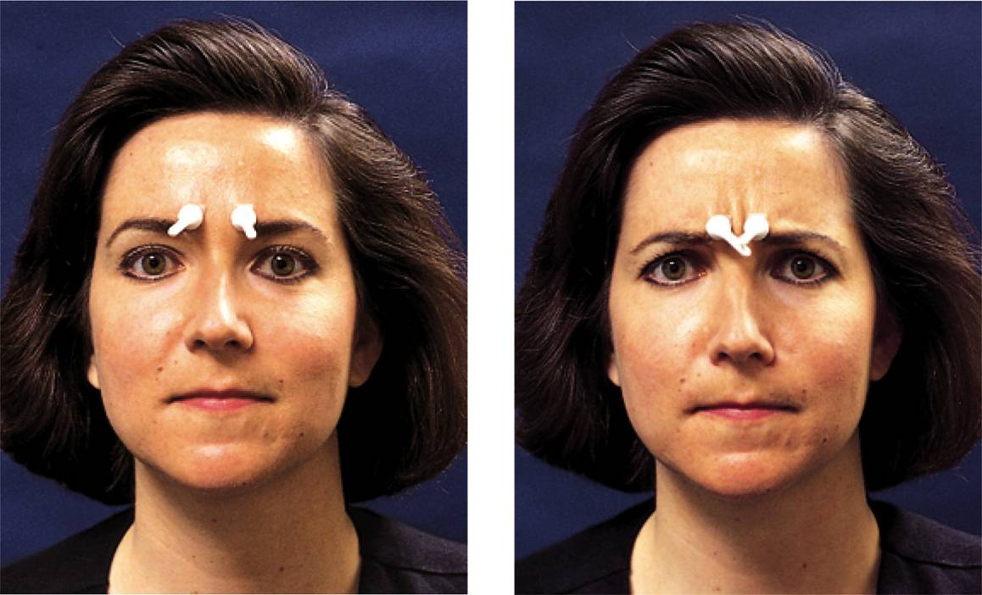
The Effects of Facial Expression
If facial expressions are manipulated, like furrowing
brows, people feel sad while looking at sad pictures.
Courtesy of Louis Schake/ Michael Kausman/
The New York Times Pictures
Attaching two golf tees to the face and making their tips touch causes the brow to furrow.
Notes:
Preview Question 7: Do our facial expressions influence our feelings?

Slide 32
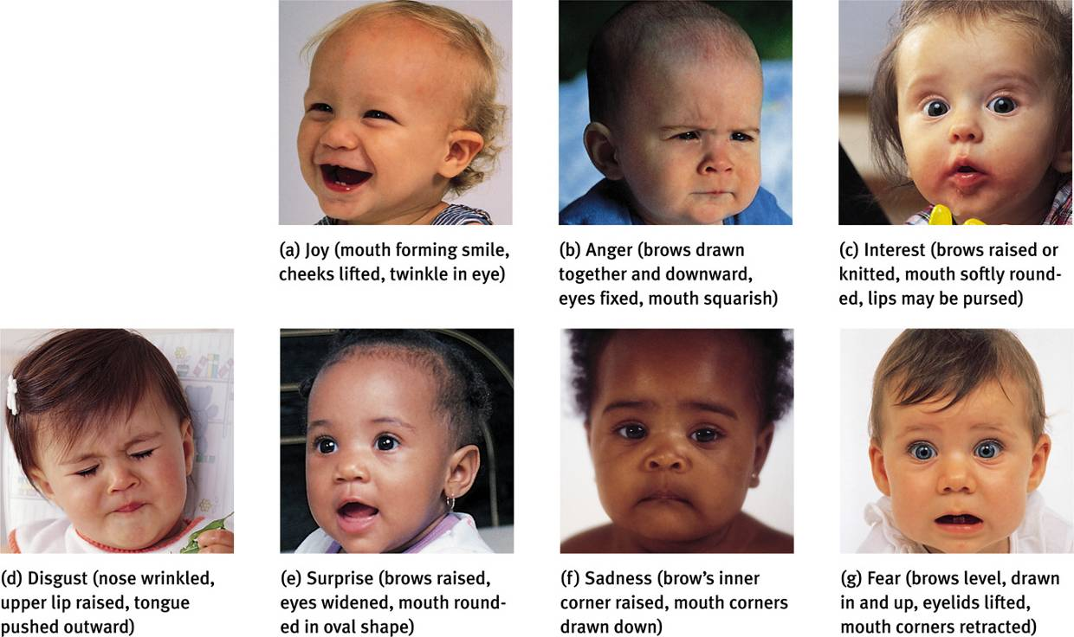
Experienced Emotion
Izard (1977) isolated 10 emotions. Most of
them are present in infancy, except for contempt,
shame, and guilt.
Patrick Donehue/ Photo Researchers, Inc.
Bob Daemmrich/ The Image Works
Tom McCarthy/ Rainbow
Lew Merrim/ Photo Researchers, Inc.
Nancy Brown/ The Image Bank
Marc Grimberg/ The Image Bank
Michael Newman/ PhotoEdit
Notes:
Preview Question 8: What is the function of fear, and how do we learn fears?

Slide 33
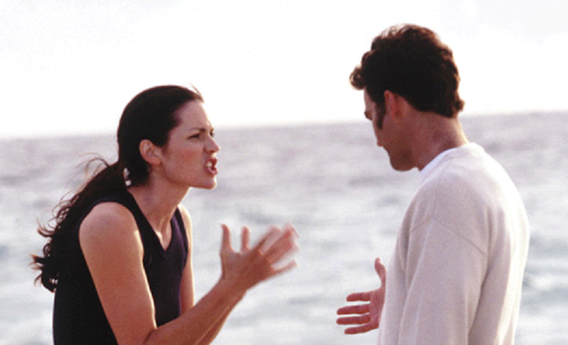
Anger
Anger “carries the mind away,” (Virgil, 70-19 B.C.), but “makes any coward brave,” (Cato 234-149 B.C.).
Notes:
Preview Question 9: What are the causes and consequences of anger?

Slide 34
Causes of Anger
People generally become angry with friends and loved ones who commit wrongdoings, especially if they are willful, unjustified, and avoidable.
People are also angered by foul odors, high temperatures, traffic jams, and aches and pains.

Slide 35
Catharsis Hypothesis
Venting anger through action or fantasy achieves an emotional release or “catharsis.”
Expressing anger breeds more anger, and through reinforcement it is habit-forming.

Slide 36

Cultural & Gender Differences
Boys respond to anger by moving away from that situation, while girls talk to their friends or listen to music.
Anger breeds prejudice. The 9/11 attacks led to an intolerance towards immigrants and Muslims.
The expression of anger is more encouraged in cultures that do not promote group behavior than in cultures that do promote group behavior.
Wolfgang Kaehler

Slide 37

Happiness
People who are happy perceive the world as being safer. They are able to make decisions easily, are more cooperative, rate job applicants more favorably, and live healthier, energized, and more satisfied lives.
Notes:
Preview Question 10: What are the causes and consequences of happiness?

Slide 38
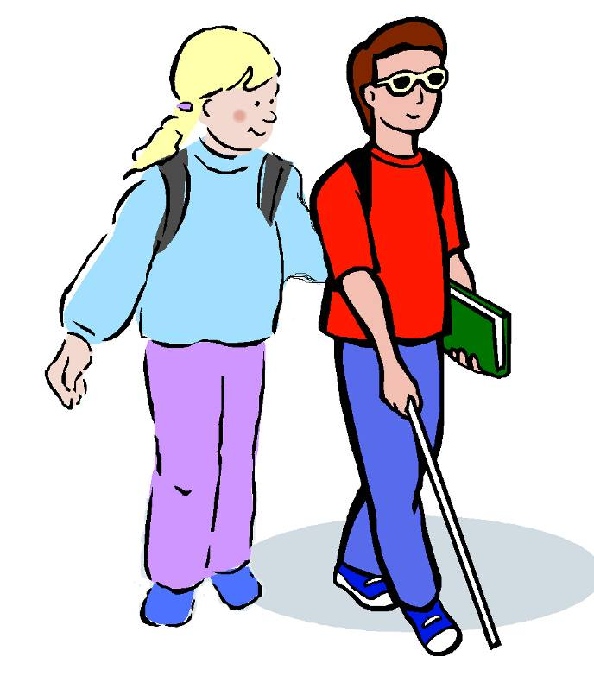
Feel-Good, Do-Good Phenomenon
When we feel happy we are more willing to help others.

Slide 39
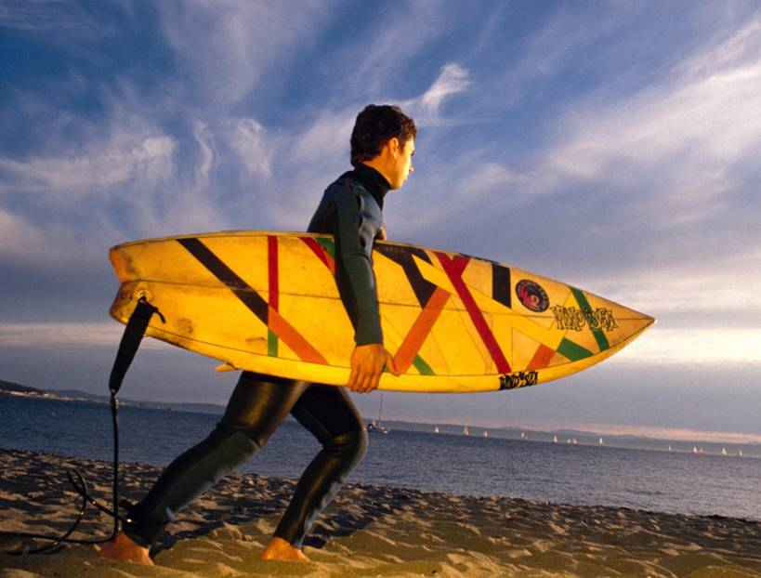
Subjective Well-Being
Subjective well-being is the self-perceived feeling of happiness or satisfaction with life. Research on new positive psychology is on the rise.
http://web.fineliving.com

Slide 40
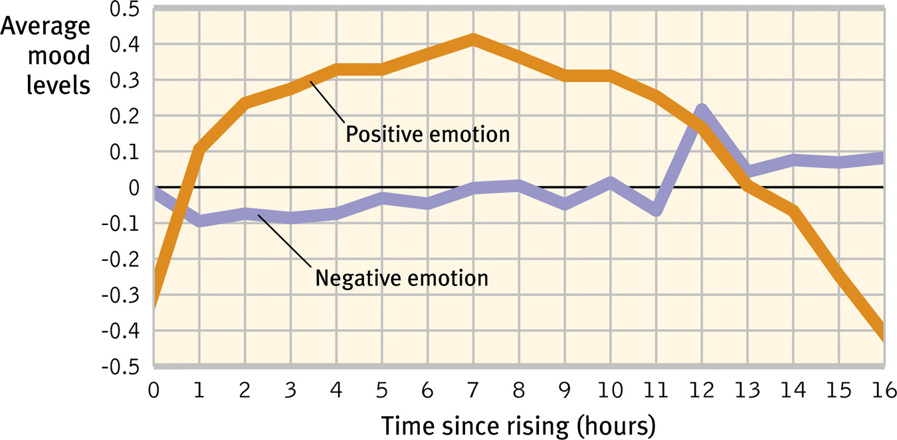
Emotional Ups and Downs
Our positive moods rise to a maximum within 6-7 hours after waking up. Negative moods stay more or less the same throughout the day.

Slide 41
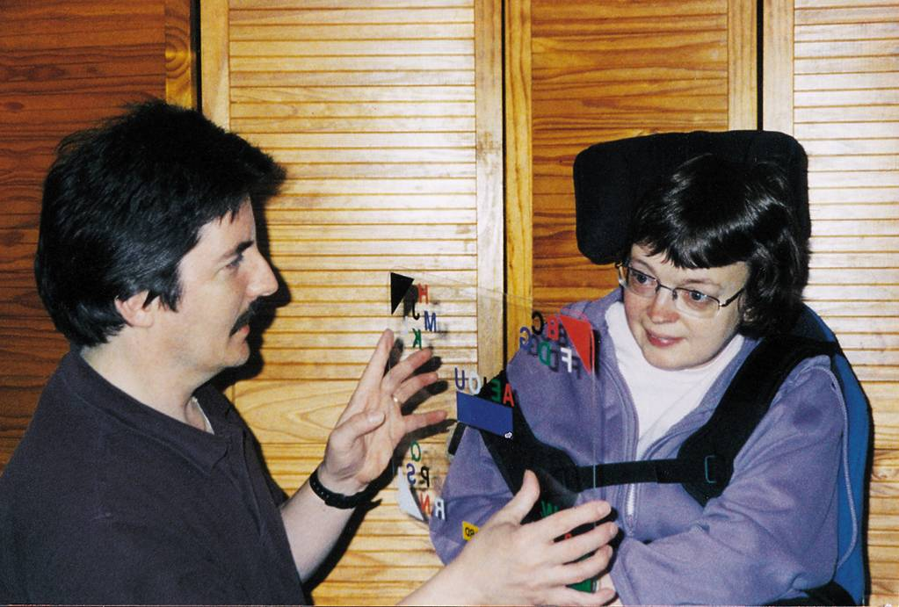
Emotional Ups and Downs
Over the long run, our emotional ups and downs tend to balance. Although grave diseases can bring individuals emotionally down, most people adapt.
Courtesy of Anna Putt

Slide 42
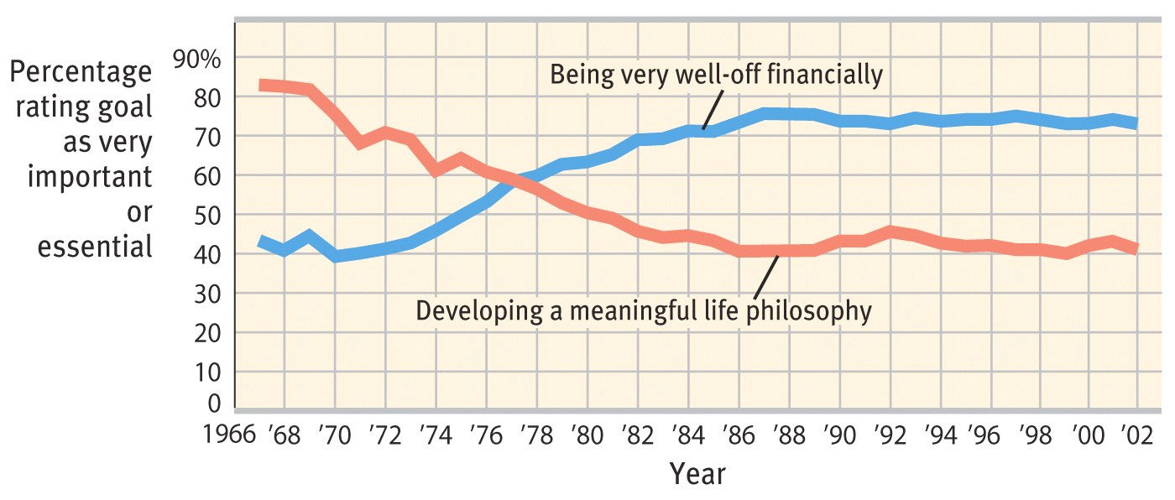
Wealth and Well-being
Many people in the West believe that if they were wealthier, they would be happier. However, data suggests that they would only be happy temporarily.

Slide 43
Wealth and Well-being
In affluent societies, people with more money are happier than people who struggle for their basic needs.
People in rich countries are happier than people in poor countries.
A sudden rise in financial conditions makes people happy.
However, people who live in poverty or in slums are also satisfied with their life.

Slide 44
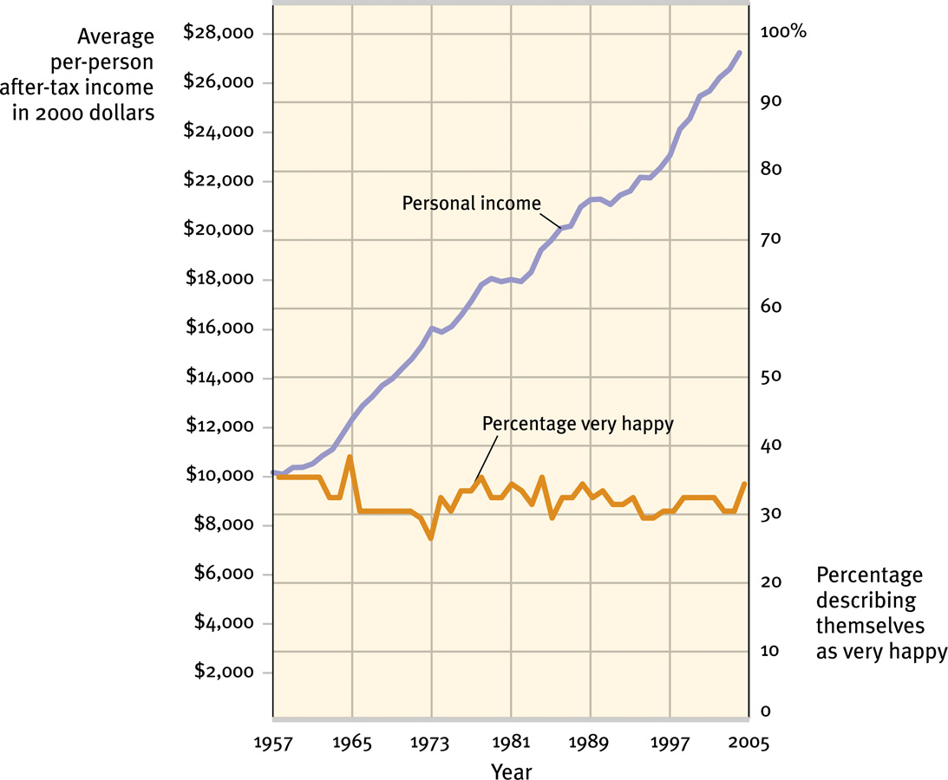
Does Money Buy Happiness?
Wealth is like health: Its utter absence can breed misery, yet having it is no guarantee of happiness.

Slide 45
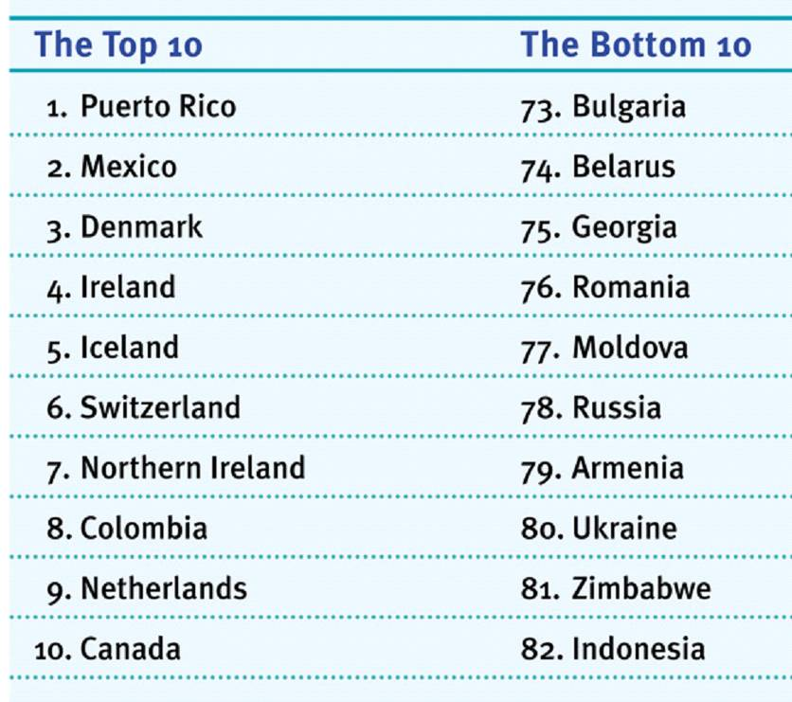
Happiness & Satisfaction
Subjective well-being (happiness + satisfaction) measured in 82 countries shows Puerto Rico and Mexico (poorer countries) at the top of the list.

Slide 46
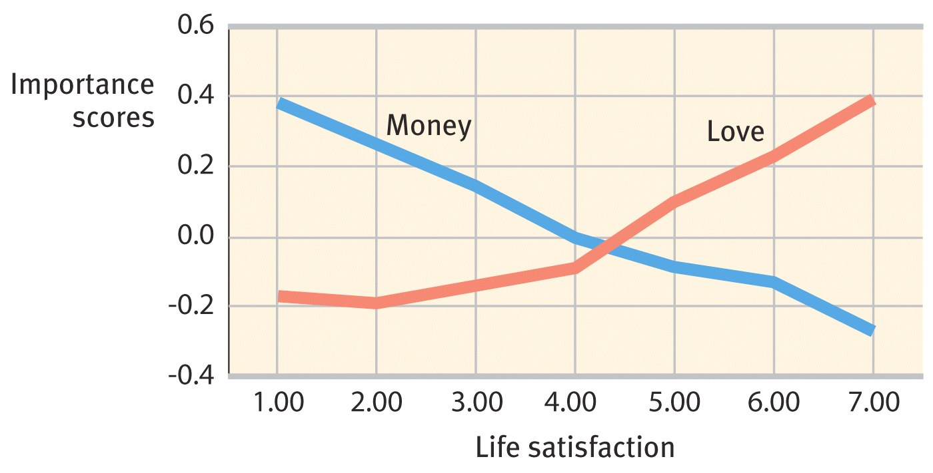
Values & Life Satisfaction
Students who value love more than money report higher life satisfaction.

Slide 47
Happiness & Prior Experience
Adaptation-Level Phenomenon: Like the adaptation to brightness, volume, and touch, people adapt to income levels. “Satisfaction has a short half-life” (Ryan, 1999).

Slide 48
Happiness & Others’ Attainments
Happiness is not only relative to our past, but also to our comparisons with others. Relative Deprivation is the perception that we are relatively worse off than those we compare ourselves with.

Slide 49
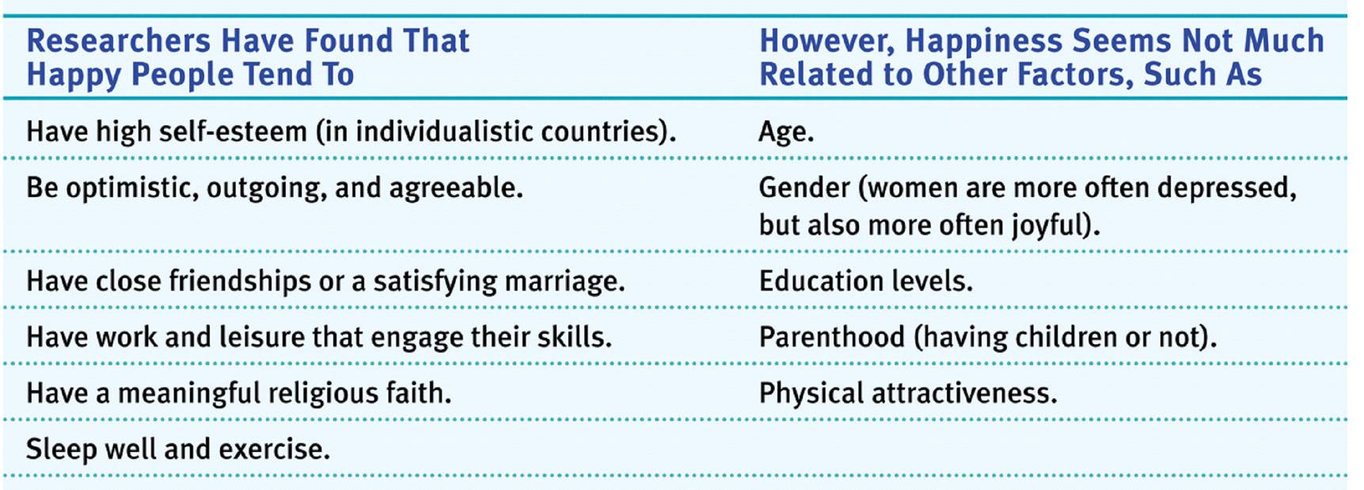
Predictors of Happiness
Why are some people generally more happy than others?

Slide 50
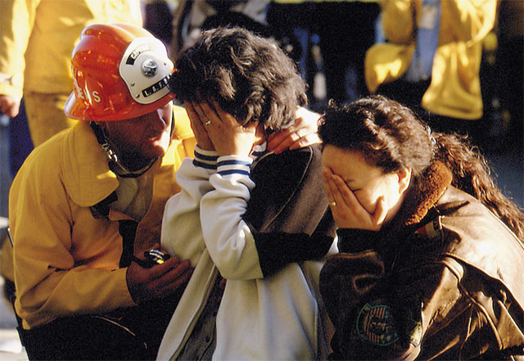
Stress and Health
Psychological states cause physical illness. Stress is any circumstance (real or perceived) that threatens a person’s well-being.
Lee Stone/ Corbis
When we feel severe stress, our ability to cope with it is impaired.
Notes:
Preview Question 11: What is stress?

Slide 51
Stress and Health
Stress can be adaptive. In a fearful or stress- causing situation, we can run away and save our lives. Stress can be maladaptive. If it is prolonged (chronic stress), it increases our risk of illness and health problems.

Slide 52
Stress and Stressors
Stress is a slippery concept. At times it is the stimulus (missing an appointment) and at other times it is a response (sweating while taking a test).

Slide 53
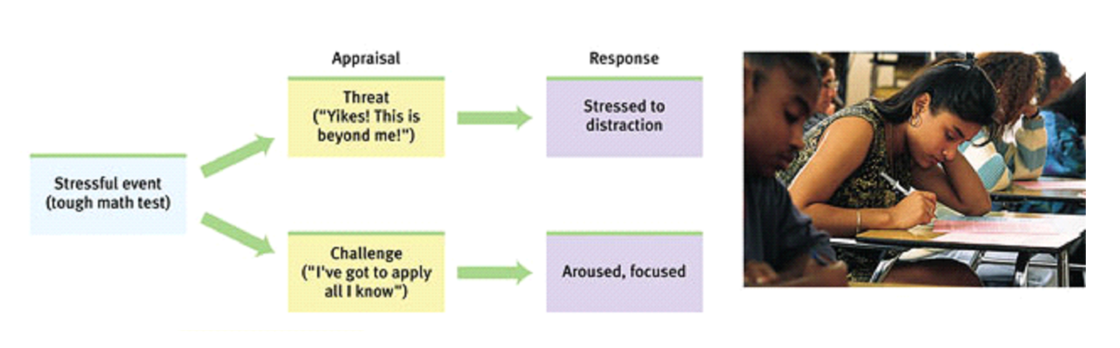
Stress and Stressors
Stress is not merely a stimulus or a response. It is a process by which we appraise and cope with environmental threats and challenges.
Bob Daemmrich/ The Image Works
When short-lived or taken as a challenge, stressors may have positive effects. However, if stress is threatening or prolonged, it can be harmful.

Slide 54
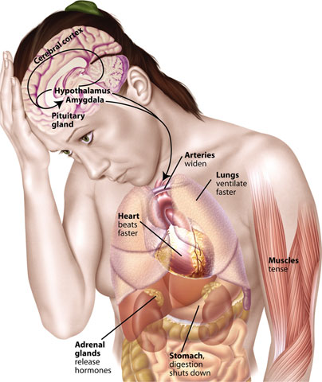
The Stress Response System
Cannon proposed that the stress response (fast) was a fight-or-flight response marked by the outpouring of epinephrine and norepinephrine from the inner adrenal glands, increasing heart and respiration rates, mobilizing sugar and fat, and dulling pain.

Slide 55
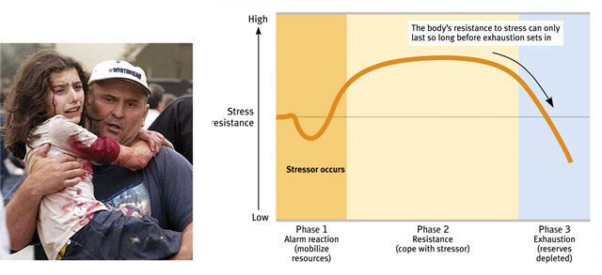
General Adaptation Syndrome
According to Selye, a stress response to any kind of
stimulation is similar. The stressed individual goes
through three phases.
EPA/ Yuri Kochetkov/ Landov

Slide 56
Stressful Life Events
Catastrophic Events: Catastrophic events like earthquakes, combat stress, and floods lead individuals to become depressed, sleepless, and anxious.
Notes:
Preview Question 12: What events provoke stress response?

Slide 57
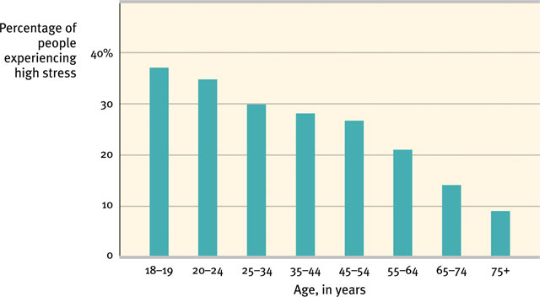
Significant Life Changes
The death of a loved one, a divorce, a loss of job, or a promotion may leave individuals vulnerable to disease.

Slide 58
Daily Hassles
Rush hour traffic, long lines, job stress, and becoming burnt-out are the most significant sources of stress and can damage health.

Slide 59
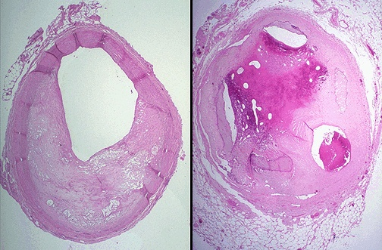
Stress and the Heart
Stress that leads to elevated blood pressure may result in coronary heart disease, a clogging of the vessels that nourish the heart muscle.
Plaque in
coronary artery
Artery
clogged
Notes:
Preview Question 13: Why are some of us more prone than others to coronary heart disease?

Slide 60
Personality Types
Type A is a term used for competitive, hard-driving, impatient, verbally aggressive, and anger-prone people. Type B refers to easygoing, relaxed people (Friedman and Rosenman, 1974).
Type A personalities are more likely to develop
coronary heart disease.

Slide 61
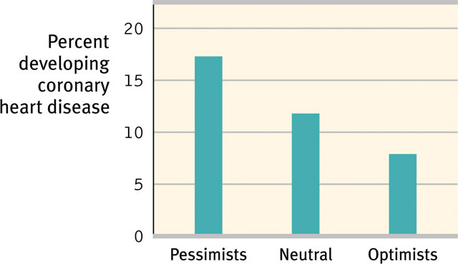
Pessimism and Heart Disease
Pessimistic adult men are twice as likely to develop heart disease over a 10-year period (Kubzansky et al., 2001).

Slide 62
Stress & Susceptibility to Disease
A psychophysiological illness is any stress-related physical illness such as hypertension and some headaches.
Psychoneuroimmunology (PNI) is a developing field in which the health effects of psychological, neural, and endocrine processes on the immune system are studied.
Notes:
Preview Question 14: How does stress make us more vulnerable to disease?

Slide 63
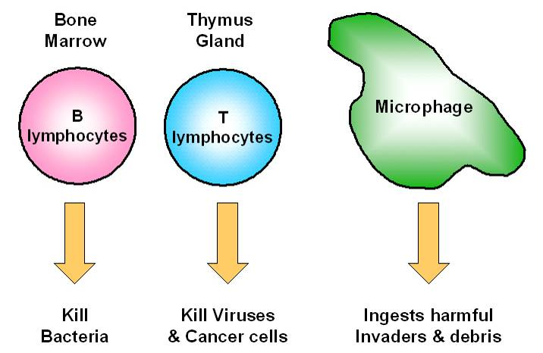
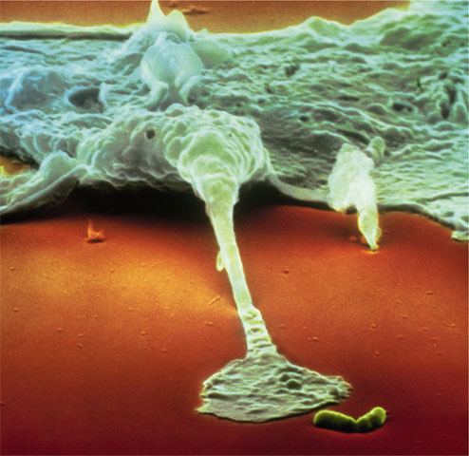
Psychoneuroimmunology
B lymphocytes fight bacterial infections, T lymphocytes attack cancer cells and viruses, and microphages ingest foreign substances. During stress, energy is mobilized away from the immune system making it vulnerable.
Lennart Nilsson/ Boehringer Ingelhein International GmbH

Slide 64
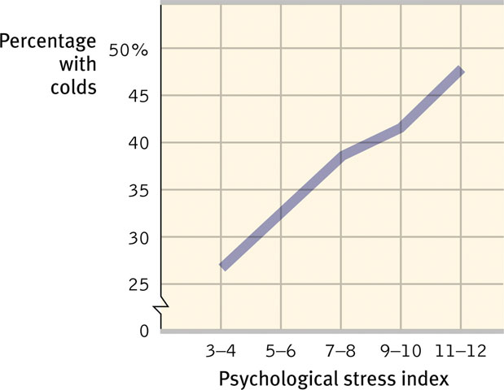
Stress and Colds
People with the highest life stress scores were also the most vulnerable when exposed to an experimental cold virus.

Slide 65
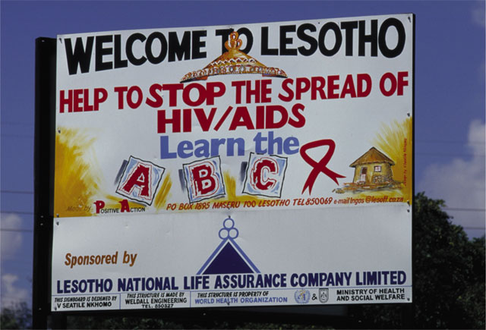
Stress and AIDS
Stress and negative emotions may accelerate the progression from human immunodeficiency virus (HIV) to acquired immune deficiency syndrome (AIDS).
UNAIDS/ G. Pirozzi

Slide 66
Stress and Cancer
Stress does not create cancer cells. Researchers disagree on whether stress influences the progression of cancer. However, they do agree that avoiding stress and having a hopeful attitude cannot reverse advanced cancer.

Slide 67
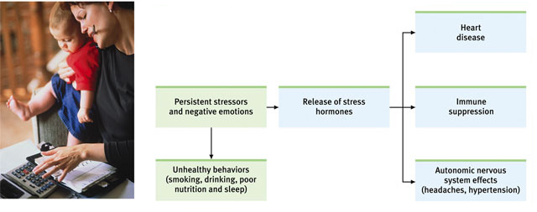
Health-Related Consequences
Stress can have a variety of health-related consequences.
Kathleen Finlay/ Masterfile

Slide 68
Behavioral Medicine
Psychologists and physicians have developed an interdisciplinary field of behavioral medicine that integrates behavioral knowledge with medical knowledge.
Mind and body interact; everything psychological is simultaneously physiological.

Slide 69
Promoting Health
Promoting health is generally defined as the absence of disease. We only think of health when we are diseased. However, health psychologists say that promoting health begins by preventing illness and enhancing well-being, which is a constant endeavor.

Slide 70
Coping with Stress
Reducing stress by changing events that cause stress or by changing how we react to stress is called problem-focused coping.
Emotion-focused coping is when we cannot change a stressful situation, and we respond by attending to our own emotional needs.
Notes:
Preview Question 15: What factors affect our ability to cope with stress?

Slide 71
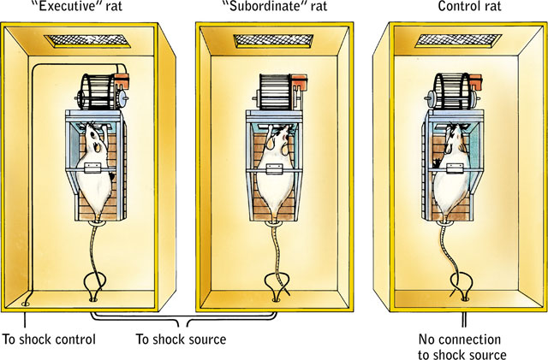
Perceived Control
Research with rats and humans indicates that the absence of control over stressors is a predictor of health problems.

Slide 72
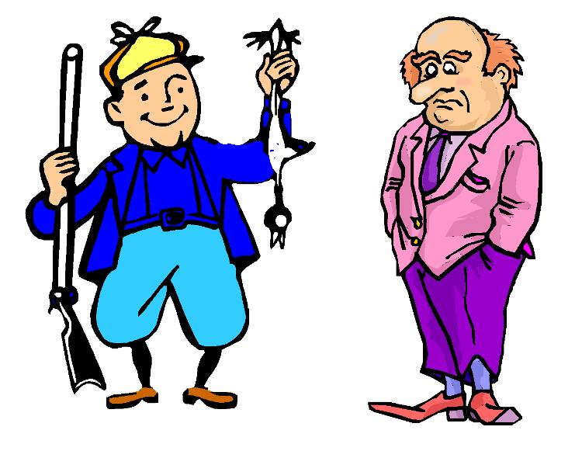
Explanatory Style
People with an optimistic (instead of pessimistic) explanatory style tend to have more control over stressors, cope better with stressful events, have better moods, and have a stronger immune system.

Slide 73


Social Support
Supportive family members, marriage partners, and close friends help people cope with stress. Their immune functioning calms the cardiovascular system and lowers blood pressure.
Bob Daemmrich/ Stock, Boston

Slide 74
Managing Stress Effects
Having a sense of control, an optimistic explanatory style, and social support can reduce stress and improve health.
Notes:
Preview Question 16: What tactics can we use to manage stress and reduce stress-related ailments?

Slide 75

Aerobic Exercise
Can aerobic exercise boost spirits? Many studies suggest that aerobic exercise can elevate mood and well-being because aerobic exercise raises energy, increases self-confidence, and lowers tension, depression, and anxiety.

Slide 76

Biofeedback, Relaxation, and Meditation
Biofeedback systems use electronic devices to inform people about their physiological responses and gives them the chance to bring their response to a healthier range. Relaxation and meditation have similar effects in reducing tension and anxiety.

Slide 77

Life-Style Modification
Modifying a Type-A lifestyle may reduce the recurrence of heart attacks.
Ghislain and Marie David De Lossy/ Getty Images

Slide 78


Spirituality & Faith Communities
Regular religious attendance has been a reliable predictor of a longer life span with a reduced risk of dying.

Slide 79

Intervening Factors
Investigators suggest there are three factors that connect religious involvement and better health.

