Slide 1
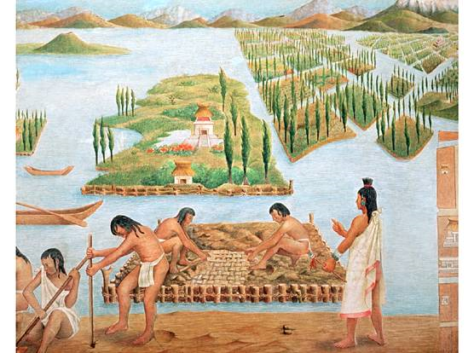
Civilizations of the America’s
Aztec
Do Now: Aztec Worksheet – Question #1 Only
AIM: What caused the fall of the Aztec civilization?

Slide 2
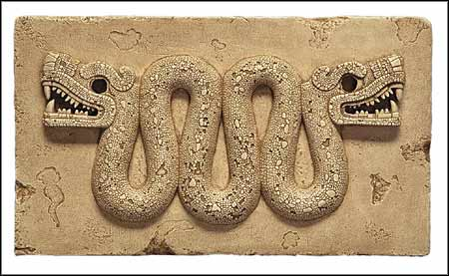
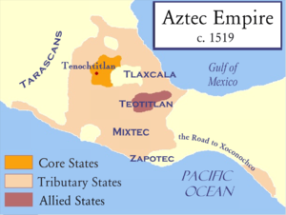
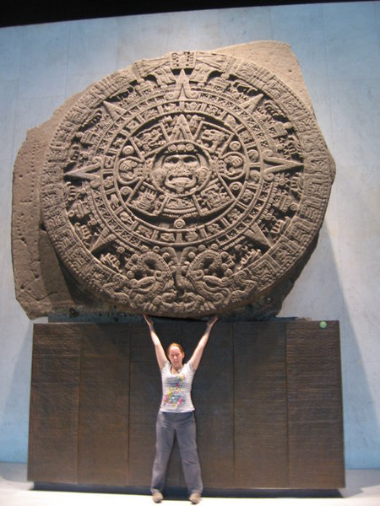
Aztec Areas

Slide 3
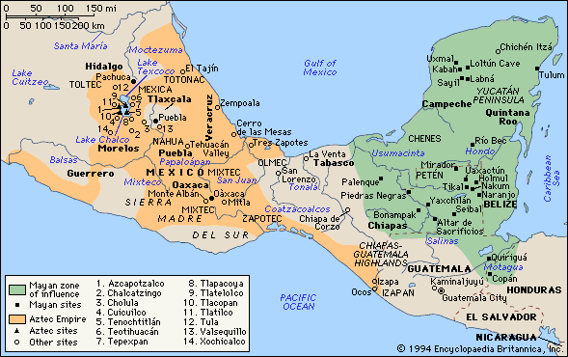
Mayan & Aztec Areas of Influence

Slide 4
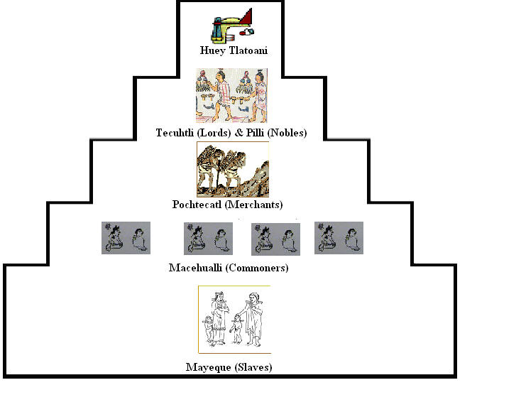
Aztecs – Social /Political / Economic
Social Hierarchy
Notes:
1. The Aztec Empire extended over southern and central Mexico in very
mountainous terrain.
2. Capital city of Teotihuacan later became the modern capital “Mexico City”
B. Aztec Conquering Principles
1. Conquered people were allowed to govern themselves but were forced to pay
Tribute (taxes) to the Aztec emperor. Aztecs became a very wealthy society.
2. Enemy soldiers were used for human sacrifices atop the Aztec pyramids. Fear
of this type of punishment reduced the threat of revolt by conquered peoples.
3. All Aztec boys were educated in schools and were taught to be fierce warriors.
These skilled soldiers easily defeated neighboring tribes of the Aztecs.
Aztec society became more hierarchical as the empire grew and differentiated social classes developed, although the older
organization based on the calpulli never disappeared. Tribute was drawn from subject peoples, but Aztec society confronted barriers that made it difficult to maintain a large population

Slide 5
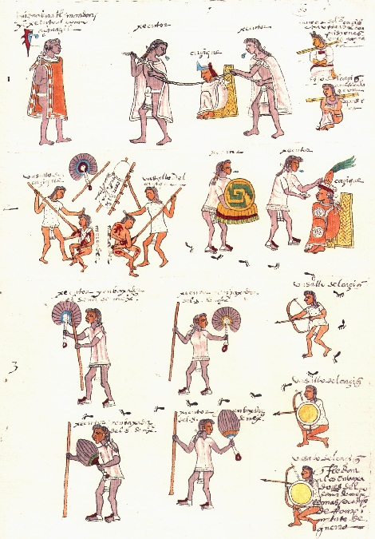
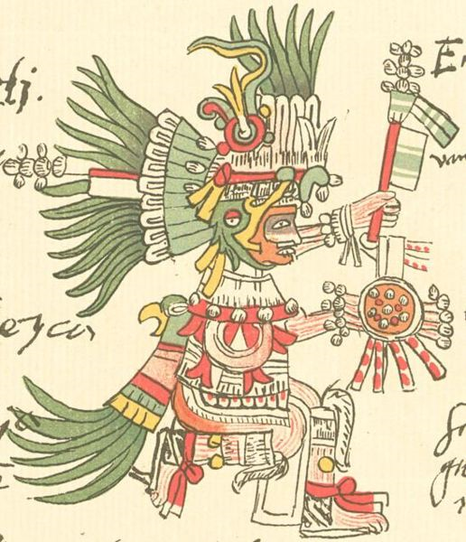
Aztecs – Social /Political / Economic
Organized for War
Huitzilopochtli - God of War & Sun
Codex Mendoza
Notes:
1. The Aztec Empire extended over southern and central Mexico in very
mountainous terrain.
2. Capital city of Teotihuacan later became the modern capital “Mexico City”
B. Aztec Conquering Principles
1. Conquered people were allowed to govern themselves but were forced to pay
Tribute (taxes) to the Aztec emperor. Aztecs became a very wealthy society.
2. Enemy soldiers were used for human sacrifices atop the Aztec pyramids. Fear
of this type of punishment reduced the threat of revolt by conquered peoples.
3. All Aztec boys were educated in schools and were taught to be fierce warriors.
These skilled soldiers easily defeated neighboring tribes of the Aztecs.
Aztec society became more hierarchical as the empire grew and differentiated social classes developed, although the older
organization based on the calpulli never disappeared. Tribute was drawn from subject peoples, but Aztec society confronted barriers that made it difficult to maintain a large population

Slide 6
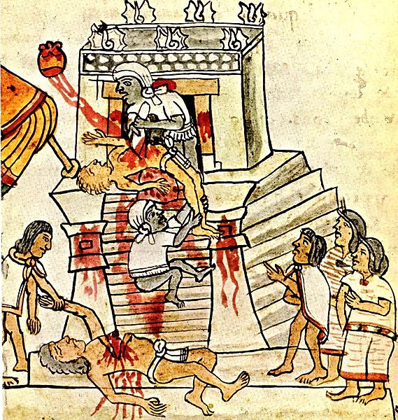
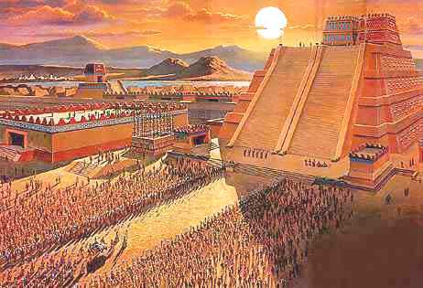
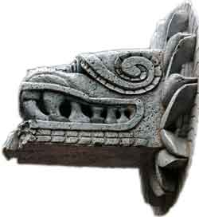
Aztecs – Social /Political / Economic
Religion & Architecture
Many Gods
Quetzalcoatl
Temples
Polytheism/Mythology
Human Sacrifice
Notes:
1. The Aztec Empire extended over southern and central Mexico in very
mountainous terrain.
2. Capital city of Teotihuacan later became the modern capital “Mexico City”
B. Aztec Conquering Principles
1. Conquered people were allowed to govern themselves but were forced to pay
Tribute (taxes) to the Aztec emperor. Aztecs became a very wealthy society.
2. Enemy soldiers were used for human sacrifices atop the Aztec pyramids. Fear
of this type of punishment reduced the threat of revolt by conquered peoples.
3. All Aztec boys were educated in schools and were taught to be fierce warriors.
These skilled soldiers easily defeated neighboring tribes of the Aztecs.
Aztec society became more hierarchical as the empire grew and differentiated social classes developed, although the older
organization based on the calpulli never disappeared. Tribute was drawn from subject peoples, but Aztec society confronted barriers that made it difficult to maintain a large population

Slide 7
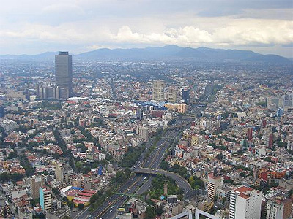
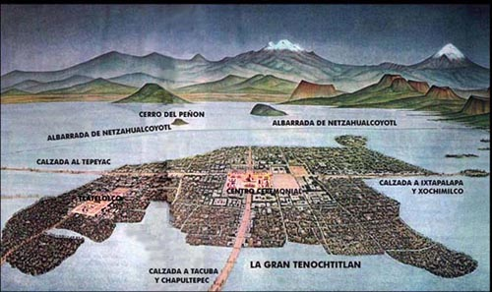
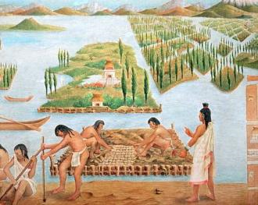
Aztecs – Social /Political / Economic
Eventually became Mexico City
Farming
Made the island in the middle of
Lake Texcoco
bigger by using reeds with sand to form islands to make farmland. Called chinampas

Slide 8
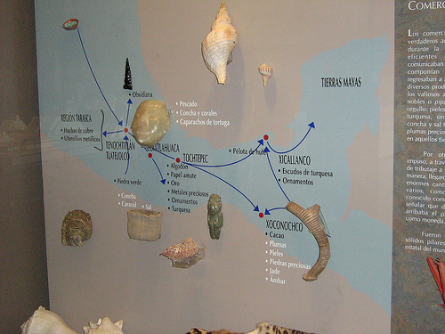
Aztecs – Social /Political / Economic
Trade
Notes:
1. The Aztec Empire extended over southern and central Mexico in very
mountainous terrain.
2. Capital city of Teotihuacan later became the modern capital “Mexico City”
B. Aztec Conquering Principles
1. Conquered people were allowed to govern themselves but were forced to pay
Tribute (taxes) to the Aztec emperor. Aztecs became a very wealthy society.
2. Enemy soldiers were used for human sacrifices atop the Aztec pyramids. Fear
of this type of punishment reduced the threat of revolt by conquered peoples.
3. All Aztec boys were educated in schools and were taught to be fierce warriors.
These skilled soldiers easily defeated neighboring tribes of the Aztecs.
Aztec society became more hierarchical as the empire grew and differentiated social classes developed, although the older
organization based on the calpulli never disappeared. Tribute was drawn from subject peoples, but Aztec society confronted barriers that made it difficult to maintain a large population

Slide 9

Aztecs – Social /Political / Economic
Notes:
1. The Aztec Empire extended over southern and central Mexico in very
mountainous terrain.
2. Capital city of Teotihuacan later became the modern capital “Mexico City”
B. Aztec Conquering Principles
1. Conquered people were allowed to govern themselves but were forced to pay
Tribute (taxes) to the Aztec emperor. Aztecs became a very wealthy society.
2. Enemy soldiers were used for human sacrifices atop the Aztec pyramids. Fear
of this type of punishment reduced the threat of revolt by conquered peoples.
3. All Aztec boys were educated in schools and were taught to be fierce warriors.
These skilled soldiers easily defeated neighboring tribes of the Aztecs.
Aztec society became more hierarchical as the empire grew and differentiated social classes developed, although the older
organization based on the calpulli never disappeared. Tribute was drawn from subject peoples, but Aztec society confronted barriers that made it difficult to maintain a large population

Slide 10
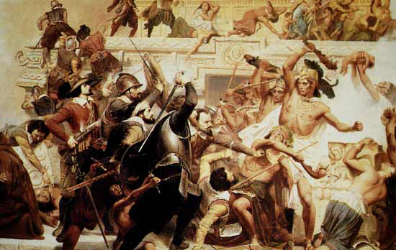
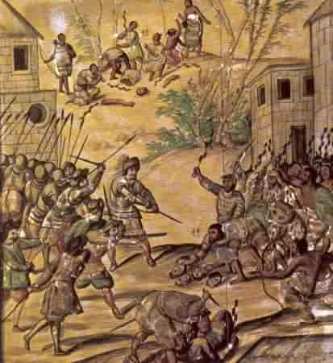
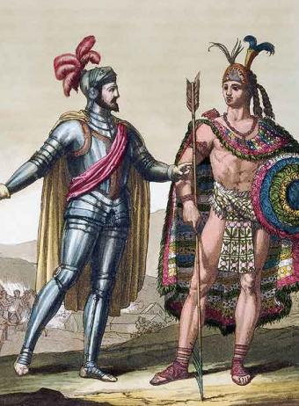
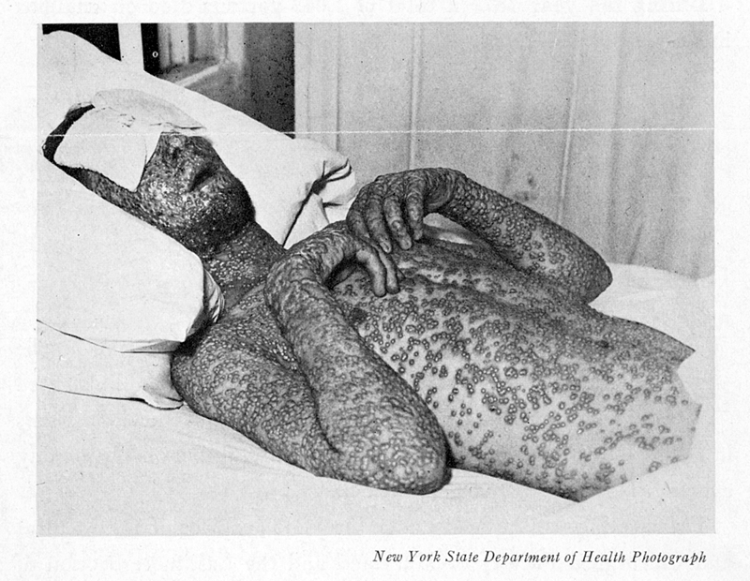
Aztecs – Decline & Fall
Spanish
  Cortes Conquered Moctezuma II in 1521
Disease – Small Pox
Conversion to Christianity
Notes:
1. The Aztec Empire extended over southern and central Mexico in very
mountainous terrain.
2. Capital city of Teotihuacan later became the modern capital “Mexico City”
B. Aztec Conquering Principles
1. Conquered people were allowed to govern themselves but were forced to pay
Tribute (taxes) to the Aztec emperor. Aztecs became a very wealthy society.
2. Enemy soldiers were used for human sacrifices atop the Aztec pyramids. Fear
of this type of punishment reduced the threat of revolt by conquered peoples.
3. All Aztec boys were educated in schools and were taught to be fierce warriors.
These skilled soldiers easily defeated neighboring tribes of the Aztecs.
Aztec society became more hierarchical as the empire grew and differentiated social classes developed, although the older
organization based on the calpulli never disappeared. Tribute was drawn from subject peoples, but Aztec society confronted barriers that made it difficult to maintain a large population

Slide 11


