Slide 1
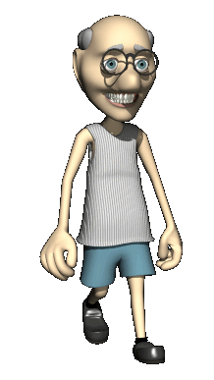
Adulthood
Early Adulthood
Middle Adulthood
Late Adulthood

Slide 2
Physical Changes
All physical abilities essentially peak by our mid twenties (this is why I am the perfect male specimen).

Slide 4
Physical Milestones
Menopause: the natural ending of a woman’s ability to reproduce.
There are physical symptoms led by a lack of estrogen.
What psychological effects can menopause have?
Men do not experience anything like menopause.
We can pretty much produce sperm forever.

Slide 5
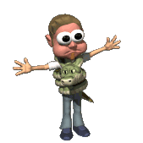
Life Expectancy
Life Expectancy keeps increasing- now about 75.
Women outlive men by about 4 years.

Slide 6
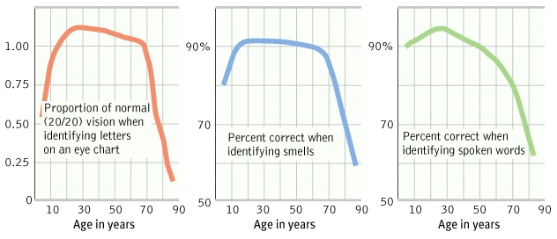
Sensory Abilities

Slide 7
Health
Bad news: is as we get older our immune system weakens, thus we become more susceptible to life threatening ailments (cancer).
Good News: because older build up a collection of antibodies throughout the years, they get minor colds less often.

Slide 8
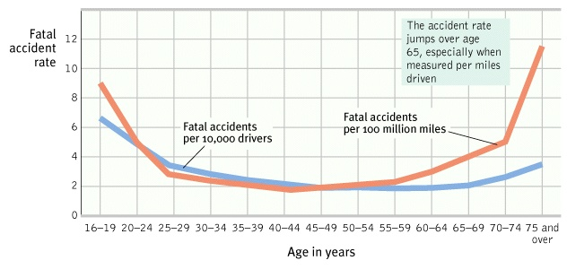
Age and Driving
The brain processes information at slower speeds.

Slide 9
Alzheimer’s Disease
A progressive and irreversible brain disorder characterized by gradual deterioration of memory, language and physical functioning.
Runs its course in 5 to 20 years.
Deterioration of neurons that produce the neurotransmitter….
Acetylcholine
Estrogen supplements may stop the onset of Alzheimer’s Disease.

Slide 10
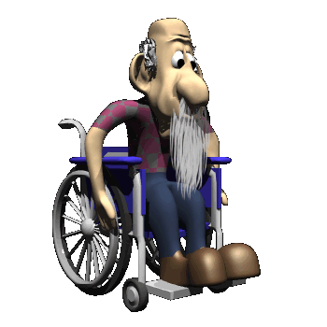
Cognitive Changes
We tend to remember events from our teens and twenties.
Difference between recognition and recall. Recognition remains stable. Recall declines with old age.

Slide 11
Do old people get stupid?
Cross-sectional studies show decline.
Longitudinal Studies show consistency.
What is the difference?
Cross-sectional studies: study with people of different ages studied at the same time.
Longitudinal Studies: same people studied and retested over a period of time.

Slide 12
But there are different types of intelligence.
Crystallized intelligence: one’s accumulated knowledge and verbal skills; tends to increase with age.
Fluid Intelligence: one’s ability to reason speedily and abstractly; tends to decrease during late adulthood.

Slide 13
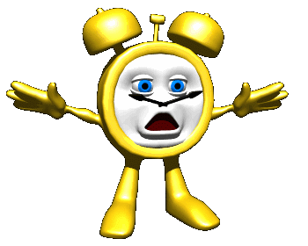
Social Development of Adults
Social Clock
Culturally preferred timing of certain events.

Slide 14
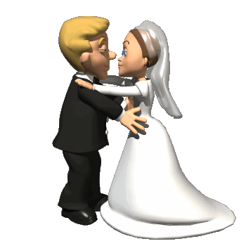
Love and Marriage
What kind of marriages work?
5 to 1 ratio of positive to negative interactions.

Slide 15
