Slide 1
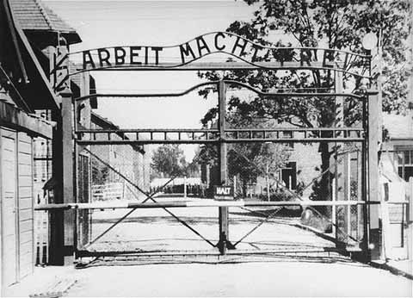
The Holocaust
1940-1945
Mr. Ott @ BETA
Notes:
This PowerPoint presentation was designed for use with my Year 11 students studying GCSE history. They were writing an essay on: What was meant by the term ‘Final Solution’ and how was it organised?

Slide 2
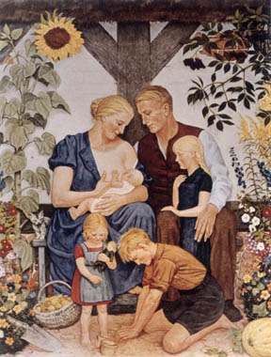
The Nazi racial stereotypical Aryan family reinforced in art. From a painting by Wolf Willrich.

Slide 3
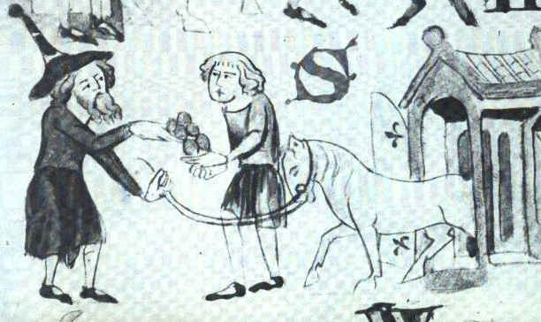
A Jew trading with a Christian, from the
Dresden Sachsenspiegel, 1220

Slide 4
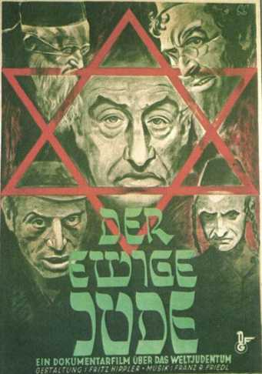
“The Eternal Jew" is the most famous Jewish Nazi propaganda film. It depicts the Jews of Poland as corrupt, filthy, lazy, ugly, and perverse. They are an alien people which have taken over the world through their control of banking and commerce, yet which still live like animals.
http://www.holocaust-history.org/der-ewige-jude/

Slide 5
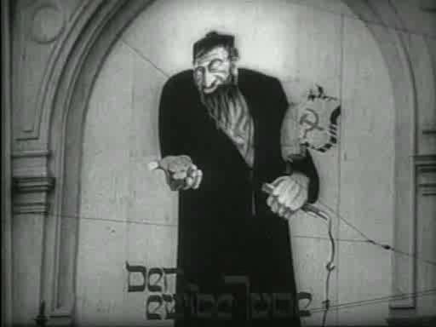

Slide 6
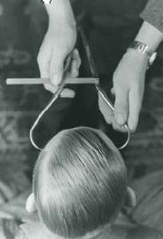
A Nazi racial hygienist measures the forehead of a young man to determine his "race", 1937

Slide 7
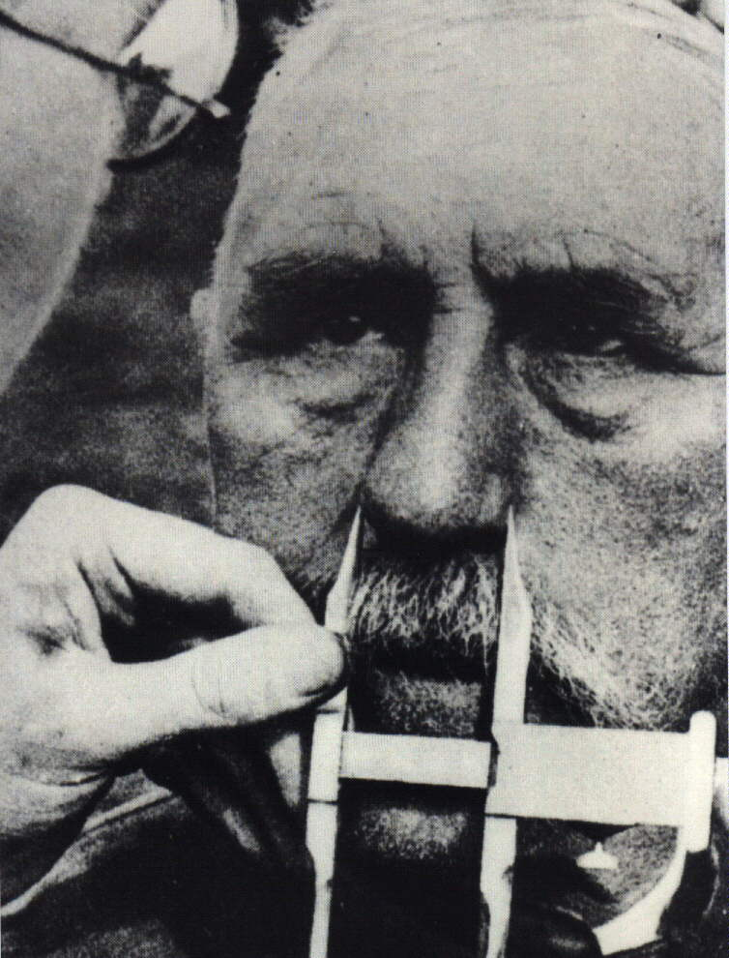
How did the Nazi decide who was Jewish?
At the Wannsee conference it was decided that if one of person’s parents was Jewish, then they were Jewish.
However, if only one of their grandparents had been Jewish then they could be classified as being German.
In 1940, all Jews had to have their passports stamped with the letter ‘J’ and had to wear the yellow Star of David on their jacket or coat.
Notes:
Some historians believe that Hitler’s grandfather was Jewish. His Grandmother used to work for a rich Jewish landowner in Austria and it is believed that she had an affair whilst she worked as his house keeper. He later helped his son get a job as a civil servant. Some Psychologists put this down as being one of the possible reasons why Hitler hated Jews. However, it is interesting to note that the Jewish doctor who helped his mother whilst she was dying of cancer was dropped off at the Swiss border by the SS in 1940!

Slide 8
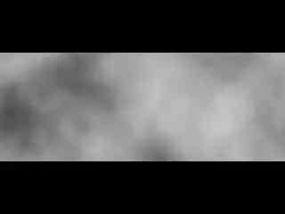
Kristallnacht

Slide 9
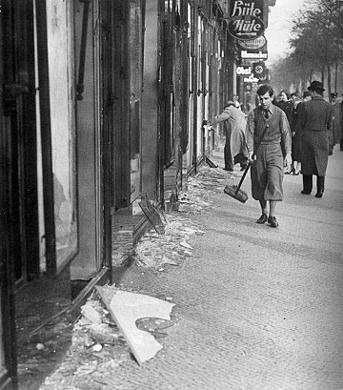
Prelude to the Final Solution
When Hitler seized power in 1933 he used his new powers under the ‘Enabling Law’ to begin his attack on the Jews.
In 1938, the Nazi attack on the Jews changed and became more violent with Himmler launching Kristallnacht on 11th November 1938.
By 1939, half of Germany’s 500,000 Jews had emigrated/left to escape Nazi persecution.

Slide 10
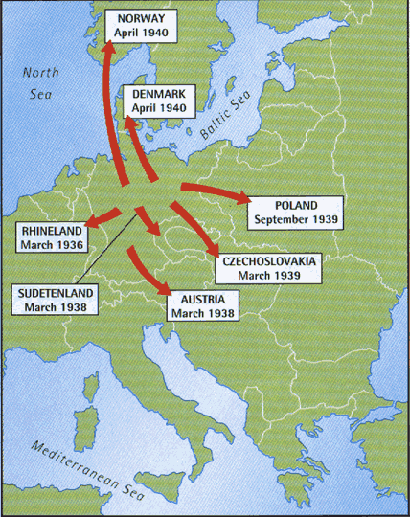
Prelude to the Final Solution
In 1939, Germany invaded Poland which had a much larger population of 3 million Jews.
In 1941, Germany invaded Russia which had a population of 5 million Jews.

Slide 11
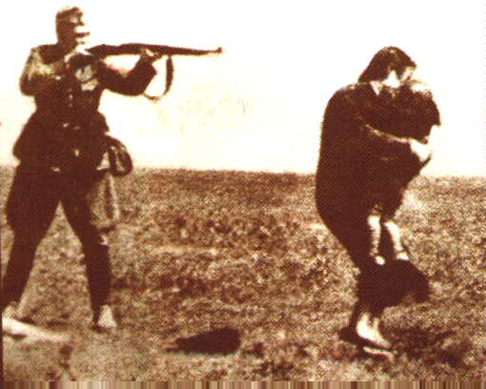
Change of Tactics:
Einsatzgruppen
Himmler sent four specially trained SS units called “Einsatzgruppen battalions” into German occupied territory and shot at least 1 million Jews.
Victims were taken to deserted areas where they were made to dig their own graves and shot.
When the SS ran out of bullets they sometimes killed their victims using flame throwers.

Slide 12
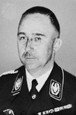
The ‘Final Solution’
In January 1942, Himmler decided to change tactics once again and called a special conference at Wannsee.
At this conference it was decided that the existing methods were too inefficient and that a new ‘Final Solution’ was necessary.

Slide 13
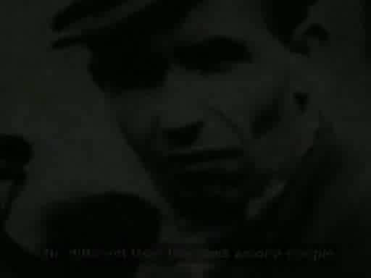
The Final Solution to the Jewish Question – Wannsee Conference

Slide 14
Wannsee Conference
Women, children, the old & the sick were to be sent for ‘special treatment.’
The young and fit would go through a process called ‘destruction through work.’
Shooting was too inefficient as the bullets were needed for the war effort
On arrival the Jews would go through a process called ‘selection.’
How was the Final Solution going to be organised?
Jews were to be rounded up and put into transit camps called Ghettos
The remaining Jews were to be shipped to ‘resettlement areas’ in the East.
The Jews living in these Ghettos were to be used as a cheap source of labor.
Conditions in the Ghettos were designed to be so bad that many die whilst the rest would be willing to leave these areas in the hope of better conditions

Slide 15
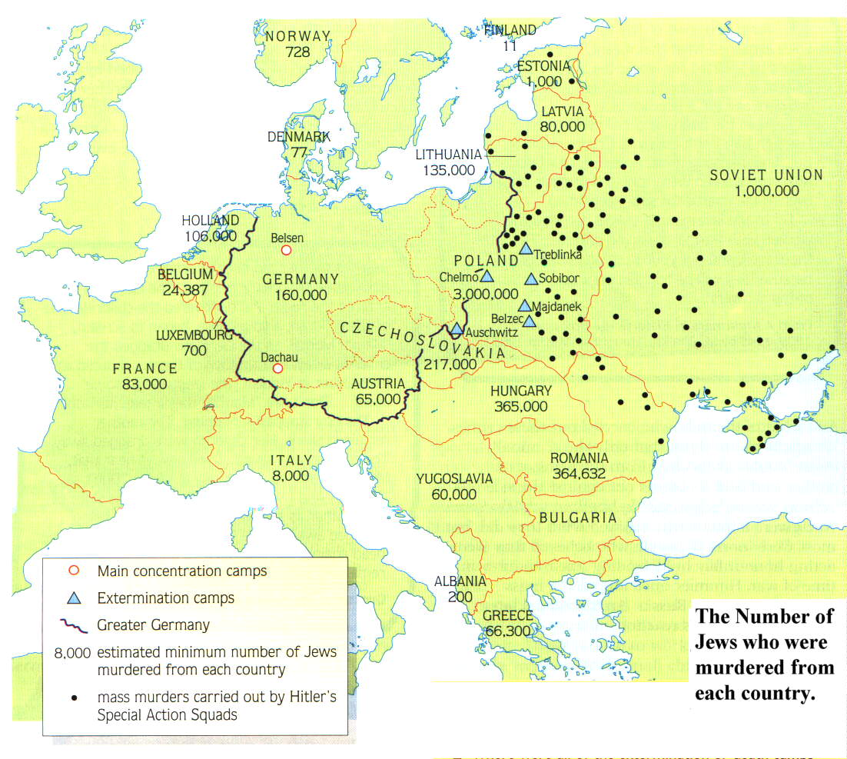
Where were the Death Camps built?
The work of the Einsatzgruppen
Why do you think that they located them here?
Notes:
Remember that the black dots represent the work of the Einsatzgruppen

Slide 16
What tactics did the Nazis use to get the Jews to leave the Ghettos?
Deception
New arrivals at the Death camps were given postcards to send to their friends.
Starvation
The Jews were told that they were going to ‘resettlement areas’ in the East.
The Jews in the Warsaw Ghetto were only fed a 1000 calories a day .
Tactics
In some Ghettos the Jews had to purchase their own train tickets.
A Human being needs 2400 calories a day to maintain their weight
Terror
They were told to bring the tools of their trade and pots and pans.
The SS publicly shot people for smuggling food or for any act of resistance
Hungry people are easier to control

Slide 17
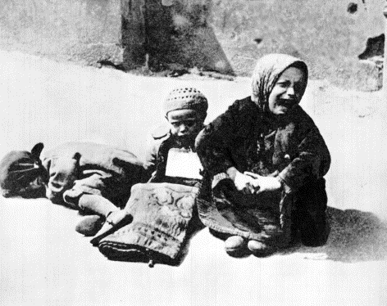
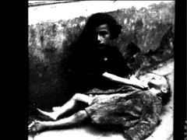
Children Dying of Starvation in the Warsaw Ghetto
Notes:
Evil is when a few good men decide to do nothing.

Slide 18
SS Tactics: Dehumanisation
The SS guards who murdered the Jews were brainwashed with Anti-Semitic propaganda.
The Jews were transported in cattle cars in terrible conditions.
Naked, dirty and half starved people look like animals, which helped to reinforce the Nazi propaganda.
The SS used to train their new guards by encouraging them to set fire to a pit full of live victims – usually children.

Slide 19
Tactics: What happened to new arrivals?
All new arrivals went through a process known as ‘selection.’
At Auschwitz the trains pulled into a mock up of a normal station.
Mothers, children, the old & sick were sent straight to the ‘showers’ which were really the gas chambers.
The Jews were helped off the cattle trucks by Jews who were specially selected to help the Nazis
Deception & Selection
The able bodied were sent to work camp were they were killed through a process known as ‘destruction through work.’
At some death camps the Nazis would play records of classical music to help calm down the new arrivals.
At Auschwitz the new arrivals were calmed down by a Jewish orchestra playing classical music.

Slide 20
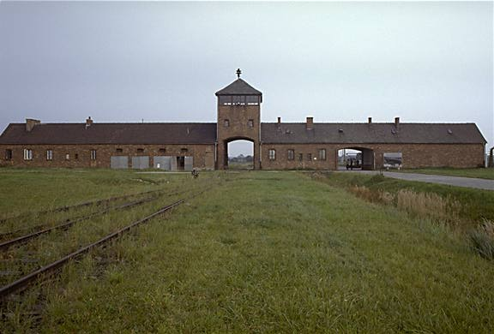
Entrance to Auschwitz
Notice how it has been built to resemble a railway station

Slide 21
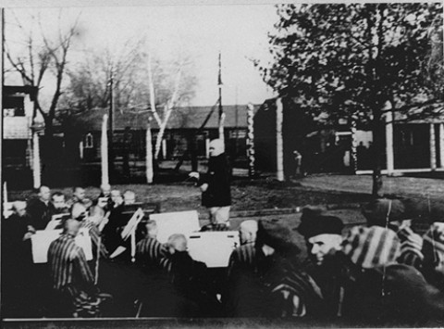
Auschwitz Orchestra

Slide 22
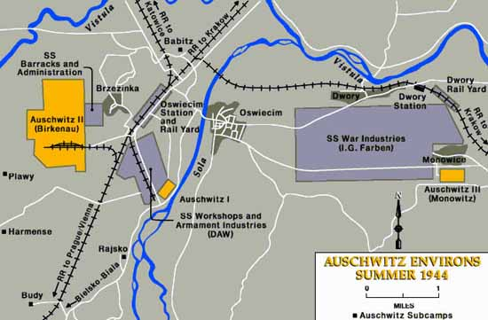
Map of Auschwitz
New Arrivals
‘Showers’
‘Destruction Through Work’

Slide 23
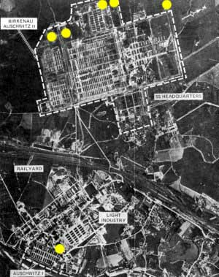
Auschwitz from the air
Notice how the Death camp is set out like a factory complex
The Nazis used industrial methods to murder the Jews and process their dead bodies
Notes:
It is important t emphasis that the Death Camps were basically factories

Slide 24
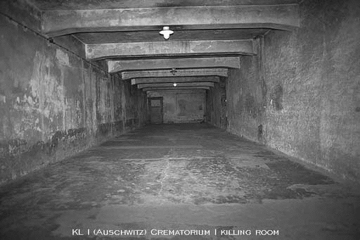
The Gas Chambers
The Nazis would force large groups of prisoners into small cement rooms and drop canisters of Zyklon B, or prussic acid, in its crystal form through small holes in the roof.
These gas chambers were sometimes disguised as showers or bathing houses.
The SS would try and pack up to 2000 people into this gas chamber

Slide 25
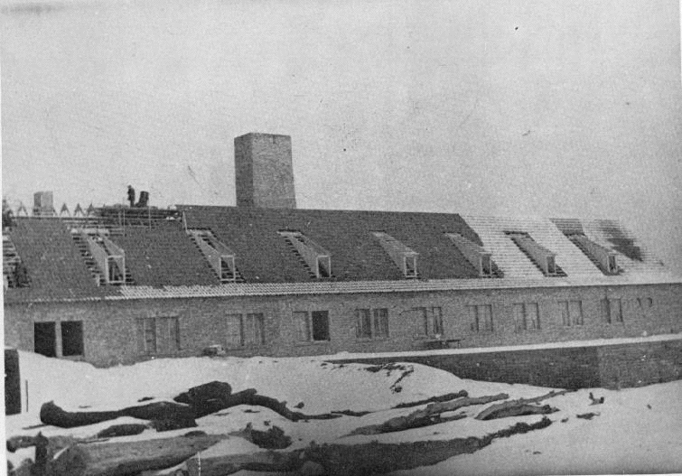
The outside of the Gas Chamber
Notice the Ovens easy located near the Gas Chambers

Slide 26
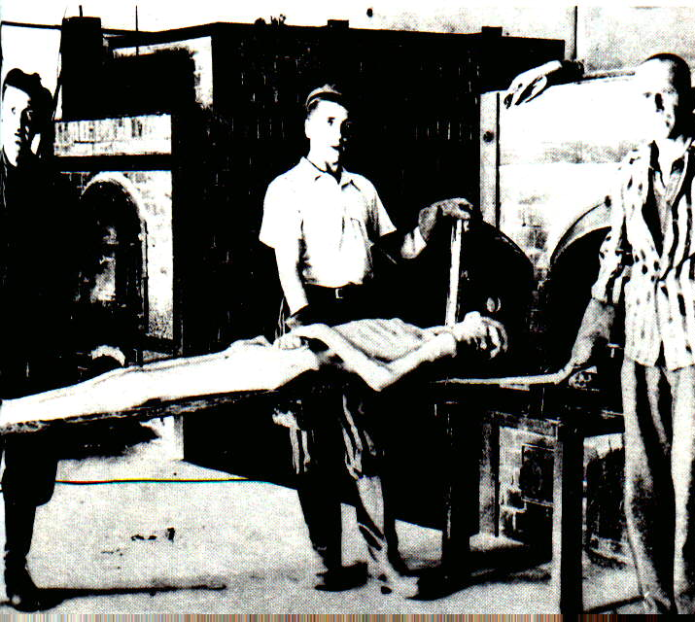
Processing the bodies
Specially selected Jews known as the sonderkommando were used to to remove the gold fillings and hair of people who had been gassed.
The Sonderkommando Jews were also forced to feed the dead bodies into the crematorium.

Slide 27
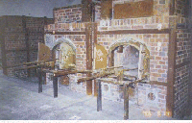
The Ovens at Dachau

Slide 28
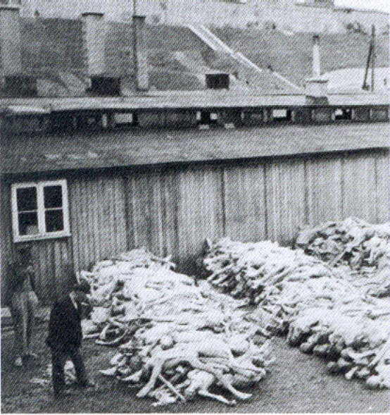
Dead bodies waiting to be processed

Slide 29
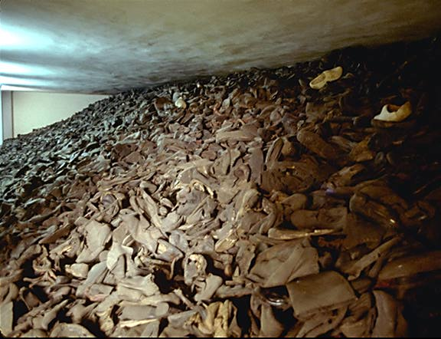
Shoes waiting to be processed by the sonderkommando
Taken inside a huge glass case in the Auschwitz Museum. This represents one day's collection at the peak of the gassings, about twenty five thousand pairs.

Slide 30
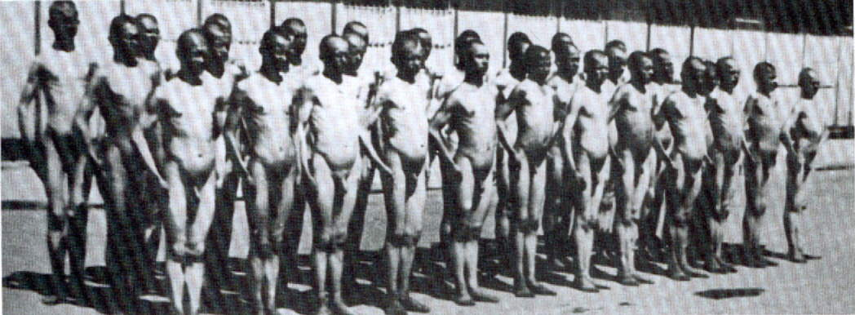
Destruction Through Work
This photo was taken by the Nazis to show just how you could quite literally work the fat of the Jews by feeding them 200 calories a day

Slide 31
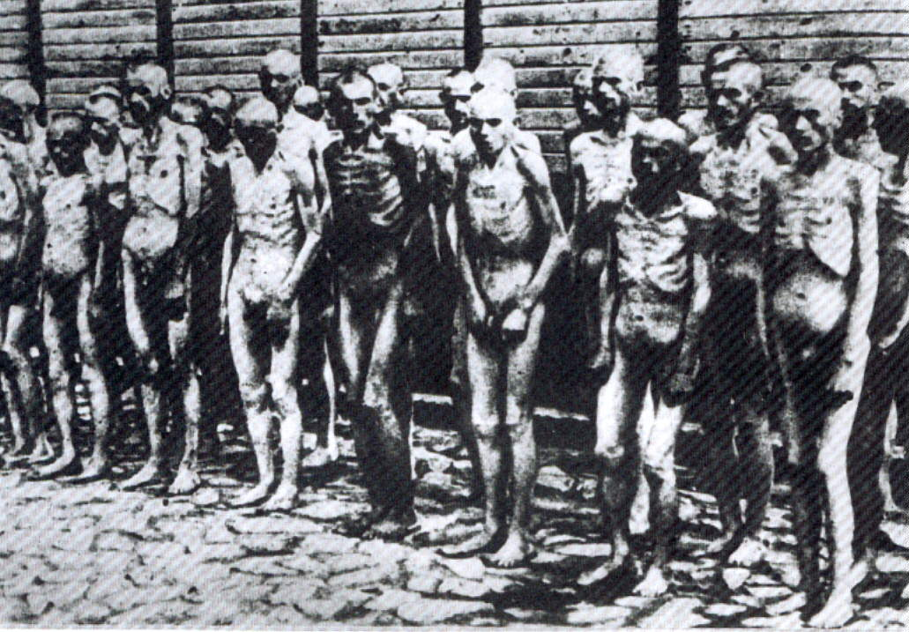
Destruction Through Work
Same group of Jews 6 weeks later

Slide 32
Was the Final Solution successful?
The Nazis aimed to kill 11 million Jews at the Wannsee Conference in 1941
Today there are only 2000 Jews living in Poland.
The Nazis managed to kill at least 6 million Jews.
Men like Schindler helped Jews escape the Final Solution.
Not all Jews went quietly into the gas cambers.
In 1943, the Warsaw Ghetto, like many others revolted against the Nazis when the Jews realised what was really happening.

Slide 33


Slide 34
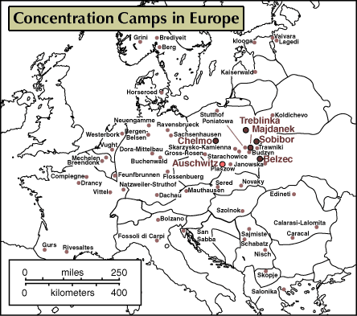

Slide 35
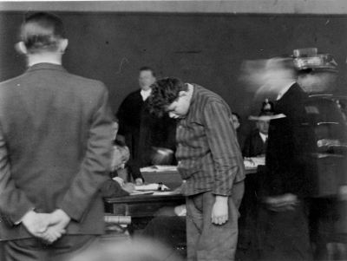
First They Came
Pastor Martin Neimoller
First they came for the communists
and I didn't speak out because I wasn't a communist.

Slide 36
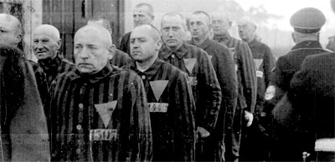
First They Came
Pastor Martin Neimoller
Then they came for
the trade unionists,
and I didn't speak out because I wasn't a trade unionist.

Slide 37
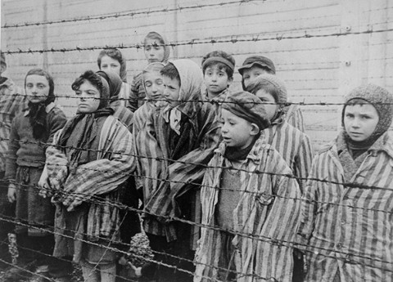
First They Came
Pastor Martin Neimoller
Then they came for the Jews,
and I didn't speak out because
I wasn't a Jew.

Slide 38
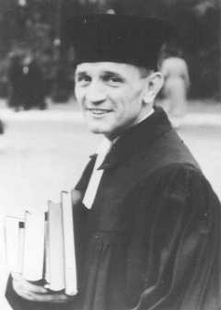
First They Came
Pastor Martin Neimoller
Then they came
for me
and there was no one left to speak out
for me.

Slide 39
The End
Evil is when a few good
men decide to do nothing.

