Slide 1
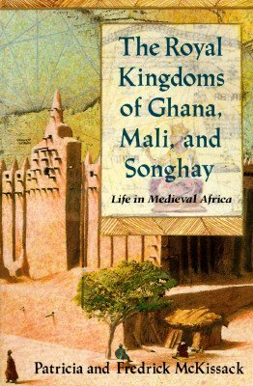
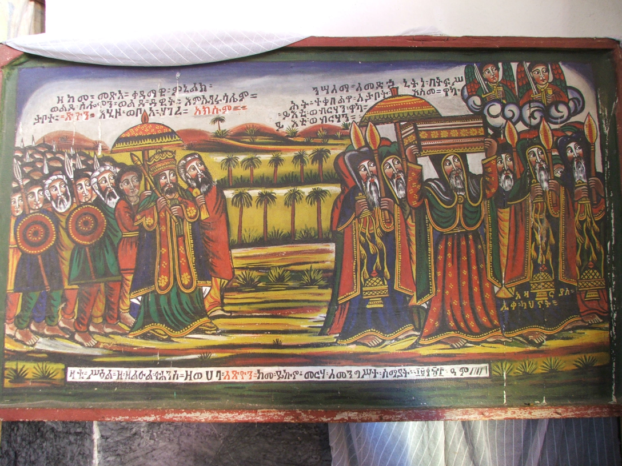
The Empires of
West & East Africa
AKSUM
Mr. Ott - Global History & Geography BETA 2010

Slide 2
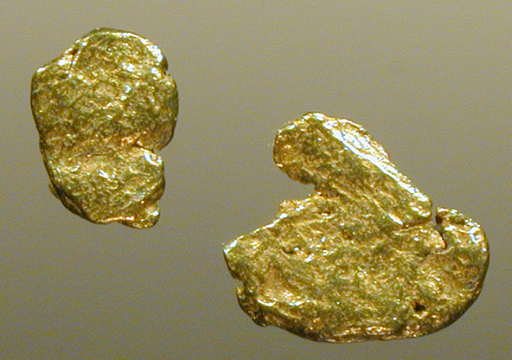
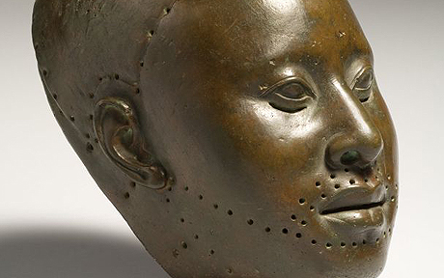
The Kingdoms of West Africa
AIM: How did the Great African Empires rise to power?
Do Now: African Empires Worksheet
Mr. Ott – Global History & Geography

Slide 3
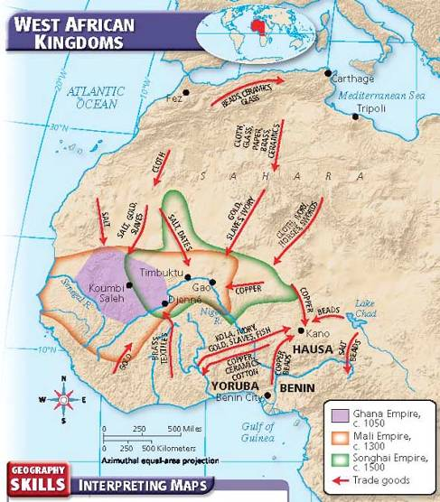
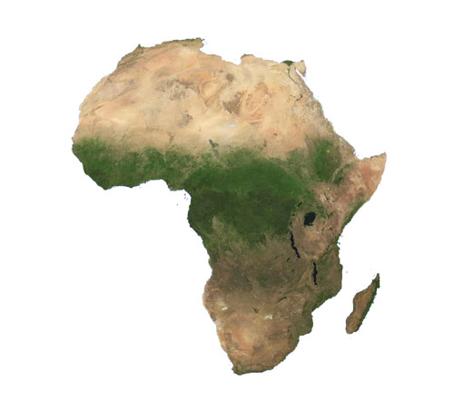
Where Are the Kingdoms Located
African Continent
Western Africa
Ghana Empire
Mali Empire
Songhai Empire
Notes:
Insert a map of your country.

Slide 4
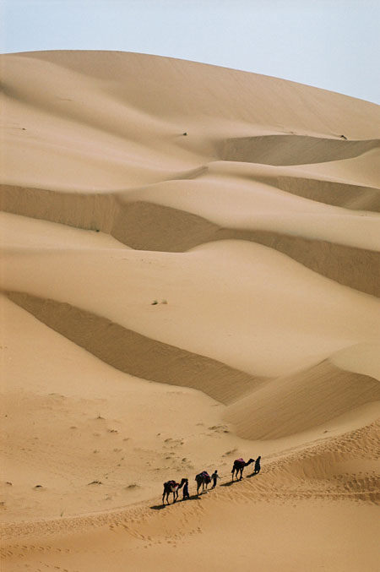
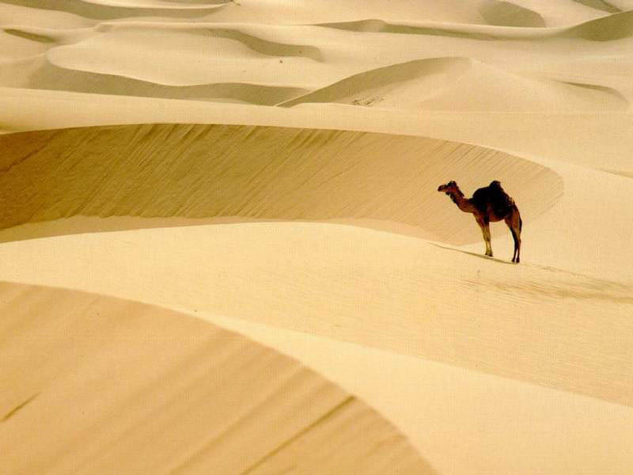
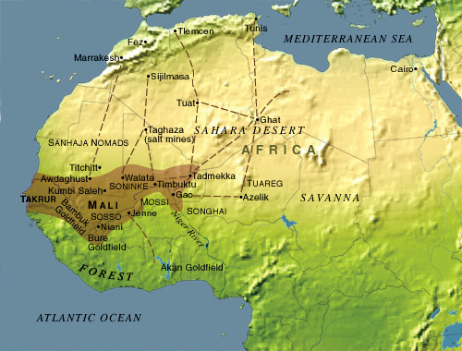
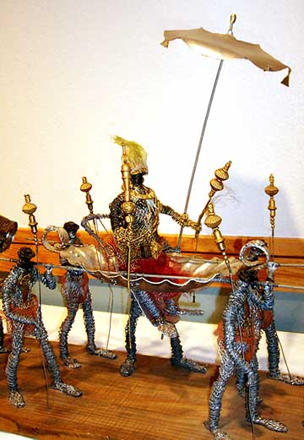
Empire of Ghana
Trade was vital to the societies of West Africa. That region produced valuable resources—notably gold—that brought high prices. By the 800s, rulers of Ghana had used the wealth from these products to create a huge, powerful empire.
The Rise of Ghana
Desert Travel
Goods for Gold
Ghana had many resources, but location delayed development as trading empire
Had no easy access to sea
Sahara desert blocked overland trade routes
First few centuries AD, North African traders learned how to cross Sahara
Traveled in large caravans with camels
Camels did not need much water, could survive trip across harsh desert
Once traders began crossing Sahara, Ghana became key player in African trade
Berber traders traded food, hard goods, copper, salt for gold
Ghana traded salt to people in south, where salt scarce
Sahara Desert
Notes:
Insert a picture of one of the geographic features of your country.

Slide 5
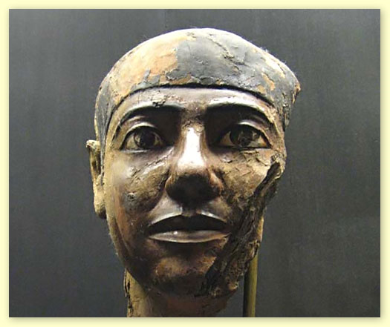
How did The Kings of ghana become so wealthy?
Per 2
Control
800 AD, Ghana controlled nearly all trade of salt, gold in sub-Saharan Africa
Capital, Koumbi-Saleh, located between Ghana’s gold mines, desert trade routes, was preferred trading place
By creating a Trading Empire by taxing salt and gold, by controlling the price of gold
Salt Taxes
Ghana’s kings built great wealth taxing goods brought to empire’s markets
Majority of taxes charged on salt: charged fee for each load of salt brought into Ghana from north, larger fee for each load exported to south
Gold Supply Scarce
Gold not taxed the same; taxes might discourage traders from buying gold
To keep gold prices high, kings ruled only they could own large gold nuggets
Others could only own gold dust; kept location of gold mines secret
This kept supply of gold scarce; kept market from being flooded
Notes:
Insert a picture of an animal and/or plant found in your country.

Slide 6
Ghana’s Decline
Attempts at Expansion
Results of Conflict
Mid-1000s, Ghana’s empire rich and powerful
King tried to expand to north into lands controlled by Almoravids, a Muslim Berber kingdom
Attempt led to long war
In 1076, Almoravids captured Koumbi-Saleh, Ghana’s capital
Ghana’s empire was weakened
King unable to deal with rebellion in part of empire
Soon Ghana fell into decline; new empire took its place

Slide 7
Mali Empire
After Ghana’s decline, no one kingdom controlled trans-Saharan trade. In the 1230s, the empire of Mali rose to power on the same territory. Mali expanded to the Atlantic Ocean and became a wealthy and sophisticated empire.
Rise of Mali
Sundiata
Founders of Mali, Malinke had been active in Ghana’s gold trade
1230, grew frustrated with policies of neighboring peoples, rose up to conquer them; became leading power in West Africa
Leader of Mali’s rise to power, king named Sundiata
After conquest, Sundiata ruled 25 years
Story of reign, accomplishments told in epic, also called Sundiata

Slide 8
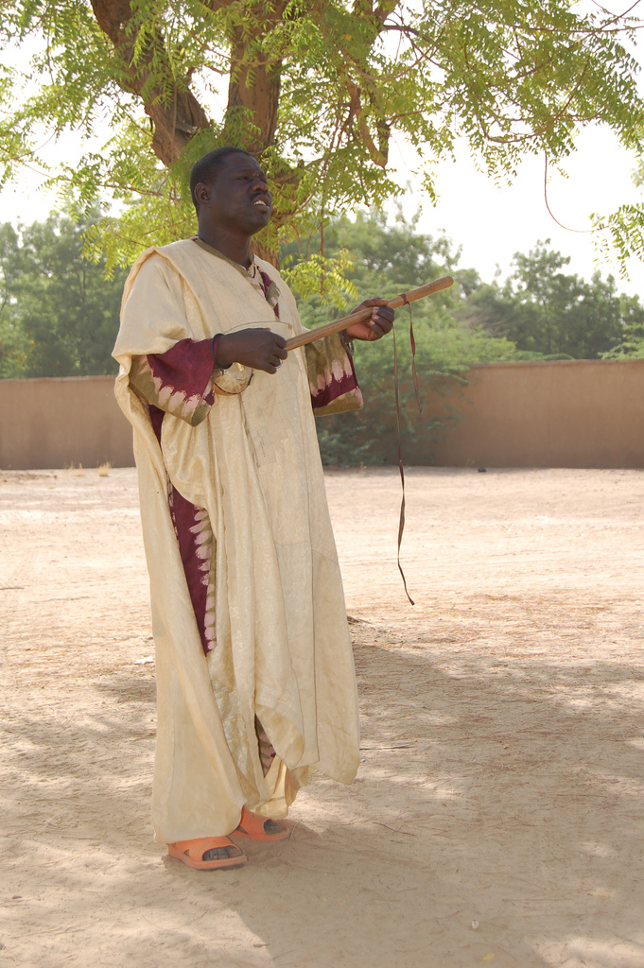
Oral History/tradition
"Listen then sons of Mali, children of the black people, listen to my word, for I am going to tell you of Sundiata, the father of the Bright Country, of the savanna land, the ancestor of those who draw the bow, the master of a hundred vanquished kings.“
13th century account handed down orally and delivered in 1960 by Mali griot, Djeli Mamdoudou Kouyate, master in the art of eloquence.

Slide 9
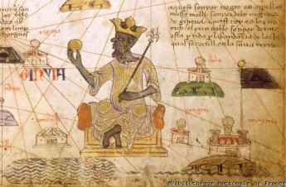
Mansa Musa
Mali reached its height in the 1300s under the reign of a mansa, or king, named Musa.
Mansa Musa came to power in 1307. During his reign, Mali’s territory expanded and its population grew.
Growing Wealth
Islam in Mali
During Musa’s reign, Mali grew wealthier than ever
Much wealth came from taxation of gold-salt trade
Mali kept order along Saharan trade routes by using large army
Army also kept life in Mali relatively peaceful
Mansa Musa devout Muslim
Introduced into West Africa by Muslim traders in Ghana, Islam did not take hold initially
In Mali, Islam became powerful influence, especially among ruling class
1324, Musa set out on hajj, pilgrimage to Mecca

Slide 10
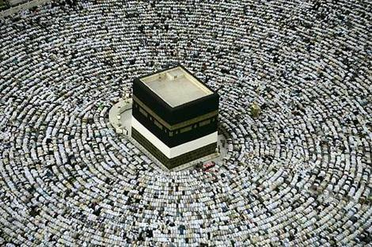
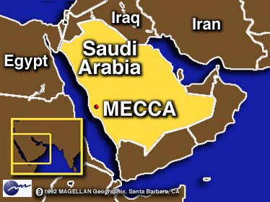
Pilgrimage to Mecca (Hajj)
Musa and entourage impressed people with their lavish clothing, generous gifts
Trip to Mecca led to great changes in Mali
Returning to kingdom, Musa brought artists, architects who designed beautiful mosques; also built schools, libraries where people could study Qu’ran, other Islamic writings
Mansa Musa
Maii
Muslim
Salt & Gold
Decline of Mali
Effects Outside Africa
Musa’s hajj brought Mali to attention of Europe
Mali began to appear on European maps for first time
Within a century, Europeans began to search West Africa for source of Mali’s riches
Rulers following Musa not as strong
Several peoples broke away, set up independent kingdoms
Mali also invaded from outside
Among invaders, Tuareg
1433, captured Timbuktu, a blow from which Mali never recovered

Slide 11
The Kingdoms of east Africa
AIM: What was the driving force behind the success of the East African Empire of Axum?
Do Now: What made the Empires of West Africa possible?
Mr. Ott – Global History & Geography

Slide 12
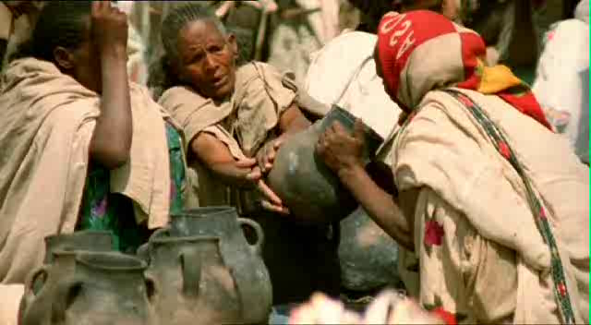
AKSUM – Ethiopia

Slide 13
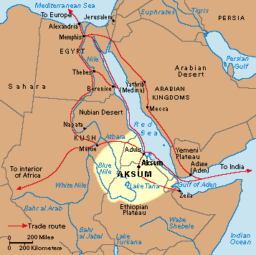
Where Are the Kingdoms Located
African Continent
Eastern Africa
Aksum Empire
  Located South
  of Egypt
  Next to Red Sea
Why is the
Geography
(Location)
important?
Control
Red Sea
Trade
Notes:
Insert a map of your country.

Slide 14
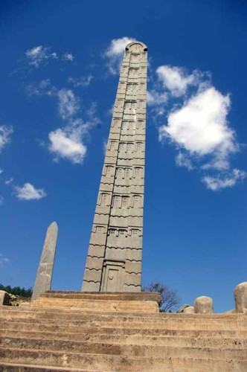
AKSUM
The growth of trade led to the development of wealthy kingdoms and city-states in East Africa.
The Rise of Aksum
People of Aksum descended from African farmers, as well as migrants from Middle East
By AD 100, Aksum was wealthy trading kingdom
Over time, Aksum became not only wealthy trading kingdom, but also strong military power
Reached Height in 300’s AD/CE
Geographic Advantages
Geographic location provided advantages: well suited for agriculture; Red Sea proximity ideal for trade, access to Indian Ocean
Seaport attracted merchants from African interior, Mediterranean region, Egypt, Arabia, Persia, India

Slide 15
Culture of Aksum
African-Arab heritage, trade connections gave Aksum diverse culture
Merchants who came to Aksum brought new ideas as well as goods
Among new ideas, beliefs in 300s, Christianity
King Ezana converted, made Christianity official religion of Aksum
Recorded that he would “rule the people with righteousness and justice…”
Language Preserved
Coins Minted
Historians know about statement because it was inscribed on stone monument, called a stela
Stelae often inscribed with records of important events
Inscriptions provide examples of Ge’ez, Aksum’s language
Ge’ez one of first written languages developed in Africa, basis of written language used in Ethiopia today
Aksum also first African kingdom south of Sahara to mint own coins
Merchants found it practical to use coins because of thriving trade

Slide 16
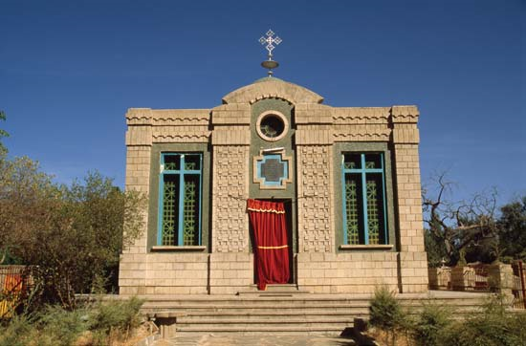
The Decline of Aksum
Muslim Invaders
600s, Aksum began to decline, partly because of arrival of Muslim invaders
600s, 700s Muslim invaders conquered parts of East, North Africa
Aksum itself was never conquered
Nearby areas became Muslim; Christian Aksum isolated cut off from trade -Aksum people eventually retreated inland, settled in what is now northern Ethiopia

